Slide 1
Panel: Assessing the Value of Biomedical Research from public and patient perspectives
NIH SMRB Meeting: October 24, 2013
Elaine K. Gallin, Ph.D.
QE Philanthropic Advisors
Notes:
It

Slide 2
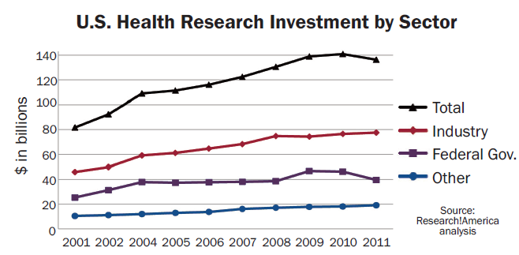
U.S. Health Research Investment
Patient Groups; Foundations, etc.
For more information, see http://www.researchamerica.org/research_investment.
Notes:
There are over 100,000 grantmaking foundations in the US In 2008 in the Us there were about 1.5 million non profit organizations and of these almost a 1 million organizations were public charities and more than 100,000 were grantmaking foundtions. While many of these not for profits orgs do not fund biomedical research – there is still wide diversity of patient advocacy groups or voluntary health organizations as well as endowed foundations whose grantmaking overlaps with the mission of NIH. It is important to emphasize that this panel reflects a very small sample of an incredibly diverse sector whose strength is derived not some much from its size (which is small compared to the investments made by the federal government and industry) but from its diversity of interests and approaches and its relative flexibility.

Slide 3
Philanthropic Funding the Health Research Continuum
Basic
Biomedical
Research
Translational
& Clinical
Research
Optimizing health delivery –
Operations
Research
Block
2
HHMI, Burroughs Wellcome, Keck
Robert Wood Johnson. Kaiser, Community HealthFoundations
Doris Duke
Voluntary Health Associations
Cystic Fibrosis Foundation, Multiple Myeloma Foundation, Juvenile Diabetes Research Foundation, American Heart Association, American Cancer Society, Susan G. Komen, etc
Adapted from IOM Clinical Research Roundtable
Notes:
Top arrow reprewents the conintuum of health research from basic through to heal
Philanthropic Sector Supports Work Throughout the entire Health Research Continuum

Slide 4
Philanthropic Sector: Assessment and Impact Evaluation
Approaches and emphasis on assessment and impact evaluation vary considerably.
Organizations focused on product development often use milestones to track progress and evaluate their investments.
In contrast, assessing career development programs, is more difficult -- career paths don’t follow rigid milestones, researchers receive support from a variety of funders and career times can be long.

Slide 5
SMRB Question 1: What NIH goals matter most to you?
Advancing knowledge whose application can improve health
Applying that knowledge to improve health
Other critically important and closely related goals:
Developing and supporting an outstanding biomedical research workforce
Contributing to U.S. competitiveness & economic growth
Fostering scientific and health literacy

Slide 6
SMRB Questions 2 & 3: Communicating NIH’s Value
Articulating compelling examples is a powerful approach.
Examples of health improvements
ARTs to treat AIDS
Gleevac to treat CML
Robotics to replace limbs
HPV vaccine and its promise to eliminate cervical cancer risk for most women
Examples of basic research achievements
Genome Project
Stem cell technology
Imaging technology
3-D printing of human tissues
Notes:
Challenge: Methodology to identify and quantify important advances in knowledge.
n you describe NIH’S value, what do you emphasize and what evidence do you use? How do you describe the connection between basic science and public health impact?

Slide 7
SMRB Question 4: Measures of Health
Multiple measures should be collected including measures that can be related to economic impact.
Measures should link new knowledge to specific health interventions and their impacts.
Improved survival- transformation of acute diseases to chronic diseases
Vaccines (and other preventions)
Evidence-based medicine and health care delivery advances that result in ‘more health for the money’
Challenge: The full impact of NIH’s health contributions can be limited by external factors (example: HPV vaccine)

Slide 8
A Suggestion
Aggregating data from different funding sectors is difficult.
To promote data harmonization and analysis and to foster collaboration among all funding sectors, NIH should rapidly share the new approaches and tools it develops.

