Slide 1
Mary Woolley, President, Research!America
Perspectives of an NIH Advocate
Oct. 24, 2013
Bethesda, MD
NIH Scientific Management Review Board

Slide 2
Making the Case for NIH: The Good News
NIH has a clear and compelling mission, i.e. funding research to improve health
The American public is positive about research, including basic research
Scientific opportunity has never been greater
Advocacy does make a difference: NIH has fared better than many other interests in recessionary times.

Slide 3
Making the Case for NIH: Challenges
Perceived lack of accountability; not enough palpable “progress”; people don’t see solutions and results
Other stakeholders in the research-for-health ecosystem don’t always feel valued or heard
Science and scientists are largely “invisible”
Economic impact analyses are unconvincing
ACA conversation consumes health mindshare, crowding out research for health
Most health care providers — the most trusted sources for research information — do not talk about research

Slide 4
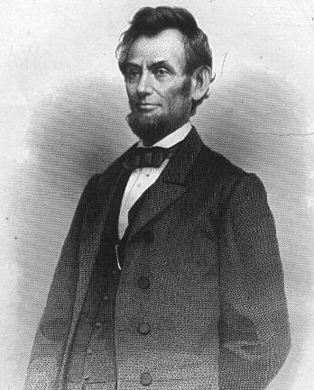
“…public sentiment is everything. With public sentiment, nothing can fail; without it nothing can succeed.”
Public Support Matters
Abraham Lincoln

Slide 5
Research!America Polling
Commissioning public opinion polls on research issues for 21 years:
National Polls
State-Based Polls
Issue-Specific Polls
Telephone (random-digit dialing) polls are conducted with a sample size of 800-1000 adults (age 18+) and a maximum theoretical sampling error of +/- 3.5%. Data are demographically representative of adult U.S. residents (state or national).
Online polls are conducted with a sample size of 1000-2000 adults and sampling error of +/-3.1%. The data are weighted in two stages to ensure accurate representation of the U.S. adult population.
Notes:
5

Slide 6
The Good News

Slide 7
Most Agree that Basic Research is Necessary
Do you agree or disagree with the following statement? “Even if it brings no immediate benefits, basic scientific research that advances the frontiers of knowledge is necessary and should be supported by the federal government.”
Source: A Research!America poll of U.S. adults conducted in partnership with Zogby Analytics in December 2012.

Slide 8
49% of Americans Say U.S. Should Not Scale Back Medical Research
The planned across-the-board budget cuts mean that, next year, the federal government would fund approximately 2,300 fewer medical research grants across the country. Which comes closer to your views on this reduction in medical research grants?
Source: A Research!America poll of likely voters conducted in partnership with Zogby Analytics, with support from United for Medical Research, in September 2012.

Slide 9
Few Likely Voters Think Gov’t Spends too Much on Research
For each of the problems listed, is the government spending …
Source: A Research!America poll of likely voters conducted in partnership with Zogby Analytics in March 2012.

Slide 10
More than Half of Americans Willing to Pay Tax for Research
Would you be willing to pay $1 per week more in taxes if you were certain that all of the money would be spent on additional medical research?
Source: A Research!America poll of U.S. adults conducted in partnership with Zogby Analytics in December 2012.

Slide 11
Research is Part of the Solution to Rising Health Care Costs
When it comes to rising health care costs, would you say research to improve health is part of the problem or part of the solution?
Source: National Public Opinion Poll, October 2011, Zogby Analytics for Research!America

Slide 12
Opinions on America’s Most Important Health Issue
What would you say is the single most important health issue facing people in the U.S. today? (first volunteered responses)
Source: Public Opinion Polls, 1992-2010

Slide 13
Demonstrating Economic Impact

Slide 14
U.S. Spends Big on Health but Ranks Low in Return on Investment
Source: Organisation for Economic Co-operation and Development; Institute of Medicine

Slide 15
Majority: Medical Research is Not Making Sufficient Progress
Do you believe that we are making enough progress in medical research in the U.S.?
Source: A Research!America poll of U.S. adults conducted in partnership with Zogby Analytics in December 2012.

Slide 16
Skepticism about Economic Impact
Source: Nature 465, June 9, 2010

Slide 17
Skepticism about Economic Impact
Source: The Breakthrough Institute (thebreakthrough.org)

Slide 18
Skepticism about Economic Impact
The main reason that countries are slow to realize the benefits of their research is because there have been few economic analyses of the knowledge economy. Better economic models are needed to understand the impact of investments.
Cunningham, P. Nature. 2013. 502:433-434

Slide 19
Standing Shoulder to Shoulder

Slide 20
Competition or Cooperation in Medical Research?
Do you think the different types of institutions conducting medical research in this country, such as government, universities, and private industry, work together to develop new treatments and cures, or do you think they are in competition?
Source: National Poll, November 2008
Charlton Research Company for Research!America

Slide 21
Research Institutions Should Work Together
Do you think the institutions conducting medical and health research in this country, such as government, universities, and private industry, should work together to develop new treatments and cures, or not?
Source: Research Enterprise Poll, February 2010
Charlton Research Company for Research!America

Slide 22
Research is Invisible

Slide 23
Most Americans Can’t Name a Living Scientist
Can you name a living scientist? (first volunteered responses)
Stephen Hawking 15%
James Watson 1%
Jane Goodall 1%
Bill Nye 1%
Michio Kaku 1%
Neil Degrasse Tyson 1%
Other 14%
Source: Your Congress – Your Health Survey, March 2011 Charlton Research Company for Research!America

Slide 24
Most Americans Don’t Know Where Research is Conducted
Can you name any institution, company or organization where medical and health research is conducted?
Mayo Clinic 10%
CDC 9%
NIH 7%
Johns Hopkins 6%
St. Jude 4%
Pfizer 3%
American Cancer Society 3%
Merck 2%
Duke Univ./Med. Ctr. 1%
OR Heath & Sci. Univ. 1%
UCSF 1%
Other 52%
Source: Your Candidates-Your Health Public Opinion Poll, October 2011, Zogby Analytics for Research!America

Slide 25
Less Than Half Know Medical Research Takes Place in Every State
To the best of your knowledge, would you say that medical research takes place in every state in the U.S.?
Source: A Research!America poll of likely voters conducted in partnership with Zogby Analytics, with support from United for Medical Research, in September 2012.

Slide 26
Few Americans Recognize the National Institutes of Health
What is the name of the government agency that funds most of the medical research paid for by taxpayers in this country? (first volunteered responses)
Source: Research Enterprise Poll, February 2010
Charlton Research Company for Research!America

Slide 27
Seven in 10 Say Doctors Don’t Talk About Medical Research
Has your doctor or other health care professional ever talked to you about medical research?
Source: A Research!America poll of U.S. adults conducted in partnership with Zogby Analytics in May 2013.

Slide 28
Specific Suggestions
Get out of the echo chamber and talk to new audiences
Design and fund economic impact studies
Create incentives for individual scientists to engage the non-science public; pilot test and scale
Educate grantees about other stakeholders, including industry and patient groups — stop expecting them to make our case if we aren’t making theirs
Open dialogue with health care providers, the most trusted sources of information about research

Slide 29
Accountability is part of our contract with the public.

Slide 30
‘A Nobel in the Family: My Brother, the Genius’
“I admire and love my brother [Paul Greengard], but he lives on a higher plane, and what he does is secret, unrevealable. To me, anyway …
“Every time he took a new job — whether at Albert Einstein College of Medicine or Yale — I’d ask him about it. Then he’d get into electro-physiological properties, and it was all over …
“Now, he has won the Nobel Prize in physiology or medicine, an honor he shares with two other scientists. In reporting it, the newspapers said their work on the way brain cells communicate might one day help cure diseases like Parkinson’s and Alzheimer’s.
“I’m thrilled he won. Now I know what he does.”
— Chris Chase in a New York Times opinion piece on October 15, 2000

Slide 31
“Scientists are obliged to make the case for science to lawmakers. … If I had to do it all over again I would spend more time talking to general audiences and public officials, penning op-eds.”
J. Michael Bishop, MD, Nobel laureate;
Research!America Advocacy Awards, March 15, 2011

Slide 32
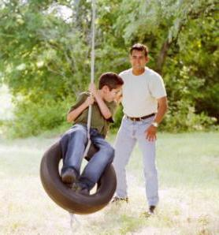
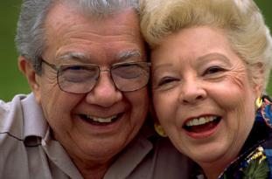
“I work for you.”

Slide 33
Connect with Research!America Online
www.researchamerica.org/blog
www.researchamerica.org/facebook
www.twitter.com/researchamerica
www.youtube.com/researchamerica

