Slide 1
Presentation to NIH Scientific Management Review Board
October 24, 2013
Concepcion R. Nierras, Ph.D.
Assistant Vice President, International Partnerships, JDRF
Notes:
The core of what JDRF is focused on is research related. The research mission is to learn more about the key aspects of T1D, then find ways to translate those learnings into potential products that eventually will be available to patients. The JDRF research team has is focused on projects that will lead to cures, better treatments and ways to prevent T1D.

Slide 2
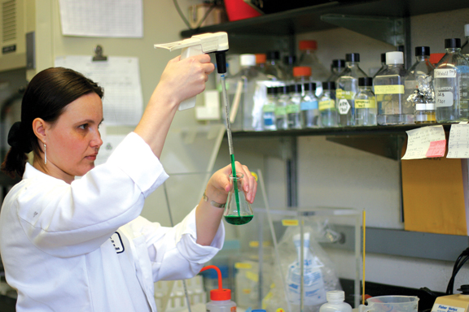
JDRF Mission
Largest charitable supporter of T1D research in the world: USD 1.7 Billion invested in research over 40+ years
In 2012, USD 110 Million in direct support, in 18 countries
JDRF’s research mission: discover, develop & deliver drugs and devices that cure, better treat, and prevent T1D
Goal of transforming lives:
Improving outcomes
Reducing daily burdens
Preventing complications
Accelerating progress towards curing T1D
Notes:
The core of what JDRF is focused on is research related. The research mission is to learn more about the key aspects of T1D, then find ways to translate those learnings into potential products that eventually will be available to patients. The JDRF research team has is focused on projects that will lead to cures, better treatments and ways to prevent T1D.

Slide 3
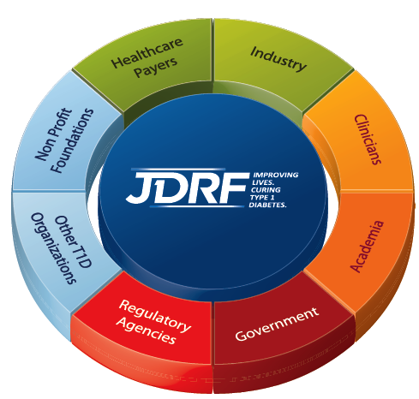
JDRF partners with all stakeholders
JDRF partnerships:
National Institutes of Health
Australia NHMRC
Canada CIHR
EFSD
Singapore A*STAR
UK Wellcome Trust
Helmsley Charitable Trust
Advocacy:
FDA
Australia TGA
EMEA
UK NICE
Notes:
JDRF has become the largest non-profit funder of T1D research.
JDRF is a global organization; seeking the best research opportunities from around the world.
Our increasing emphasis on translating research into products is shown by the number of clinical studies we fund, a number that has grown significantly over the past 5-10 years.
JDRF is routinely rated among the most efficient non-profit organizations as shown by the facts and how others describe JDRF. Supporter can trust JDRF to use their donations wisely.
Since its founding in 1970, we’ve funded more than one and a half billion dollars in type 1 diabetes research; we’ve drastically advanced the T1D scientific frontier. JDRF’S research unites the best and the brightest minds from around the world and we support programs with the greatest potential for achieving our goals.

Slide 4
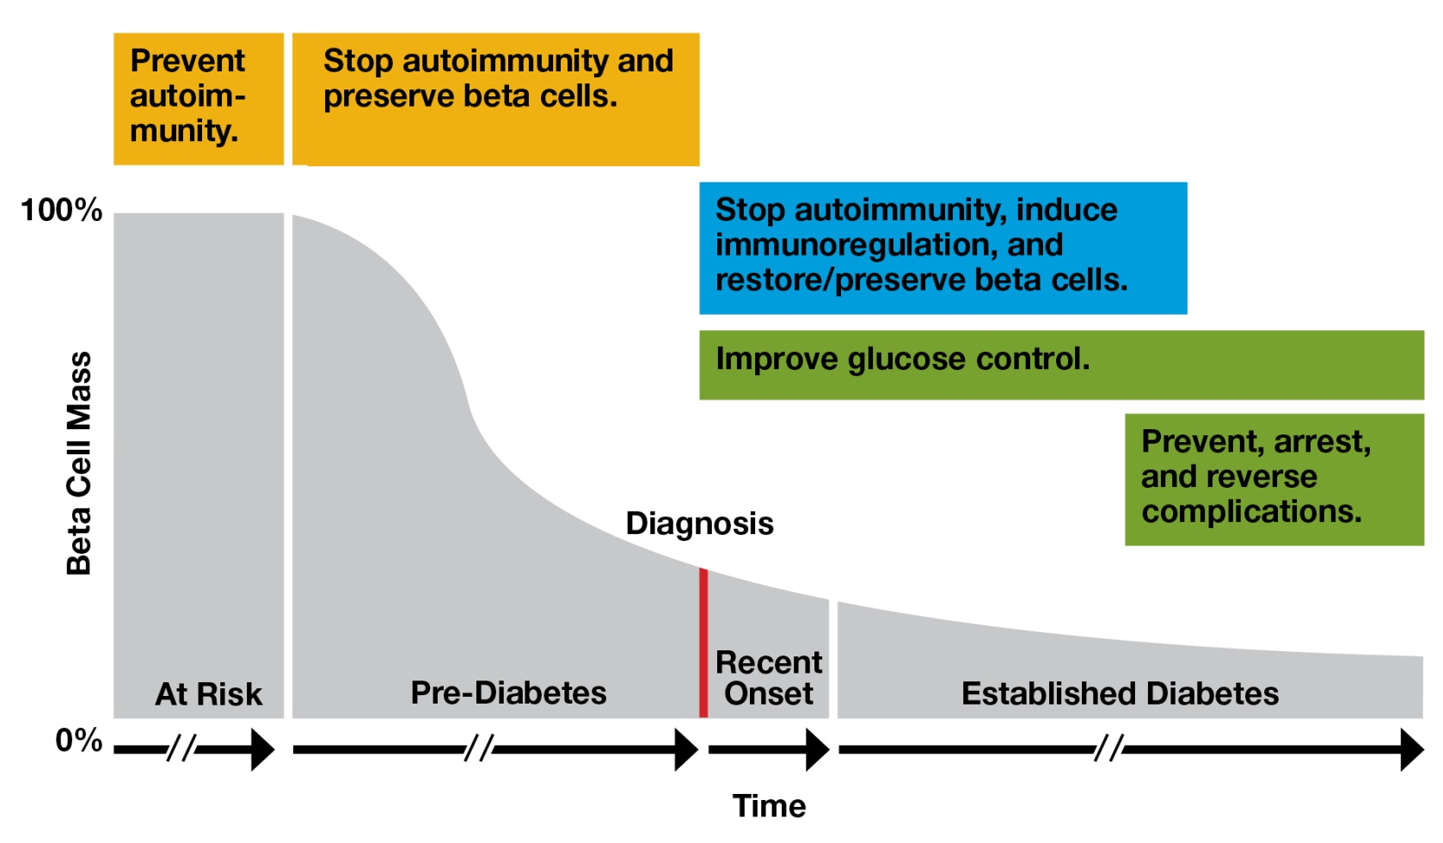
JDRF Research Strategy “All T1D Stages and All Ages”
PREVENT
CURE
1st Prevention
Prevent Autoimmunity
2nd Prevention
Stop Autoimmunity
Prevent Beta cell Loss
Stop Autoimmunity
Preserve / Restore Beta cells
Induce Immunoregulation
TREAT / PREVENT
Functional
Improve Glucose Control
Prevent / Arrest / Reverse COMPLICATIONS
From G Eisenbarth

Slide 5
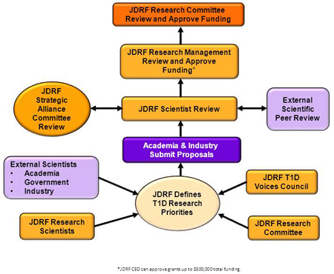
How does your organization set goals?
Identifying gaps and opportunities
Innovating mechanisms
Research funding oversight
Volunteers are an important part of JDRF
JDRF Research Committee
T1D Voices Council
Consultation with partners (govt, other foundations, and industry)
Input from scientific experts (academia, govt and industry)

Slide 6
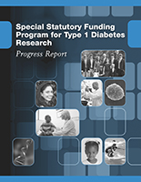
How does your organization assess whether it is meeting its goals?
Evaluation of scientific progress
Annual reporting includes evaluations/site visits
Milestone-based payments for awards
How does this research contribute to understanding of disease?
Evaluation of program effectiveness
Partnerships:
Did it achieve its goals?
Was the science successful?
Are there new opportunities?
Mechanisms:
Training: did awardee make a career in diabetes research?

Slide 7
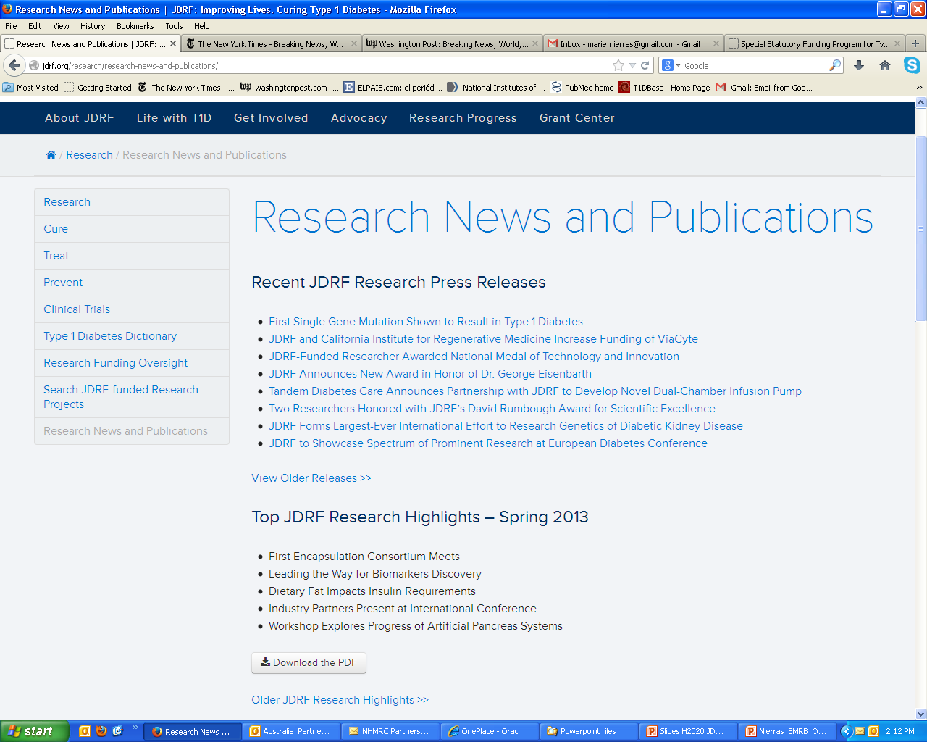
Communicating results

Slide 8
You Make A Difference – Thank You!
Give generously to speed JDRF research to cure, better treat and prevent T1D
Join a JDRF walk, ride, gala or other fund- raising event
Volunteer at your local JDRF chapter
Participate in clinical research
Learn more at: jdrf.org
Notes:
Here you should summarize your key messages:
JDRF research efforts are driven by a sense of urgency and passion.
JDRF research has help improve the lives of millions of people with T1D.
JDRF is focused on delivering transformative results to people with T1D.
Now ask your audience to join us and help us achieve our goals. There are multiple ways they can help us, including:
Donating directly thru a local JDRF chapter or at jdrf.org.
Participate in a local JDRF chapter fund-raising event.
Volunteer their time at a local JDRF chapter.
Participate in clinical research if they are a person with T1D or a close relative of someone with T1D.
Thank everyone for their attention.

Slide 9
Living with Diabetes: People with Type 1 Diabetes Are Living Longer, Healthier Lives
Diagnosis
1975-1980
1970-1974
1965-1969
1960-1964
1950-1959
1.0
0.9
0.8
0.7
84%
0.6
80%
Cumulative Survival
Reduction
in mortality
compared to
1950-1959 cohort
41%
0.5
0.4
0.3
0.2
0.1
0
10
20
25
30
40
50
Diabetes Duration at Death (years)
Figure adapted from Diabetes 55: 1463-1469, 2006
Figure adapted from Diabetes 55: 1463-1469, 2006
Notes:
9

