Slide 1
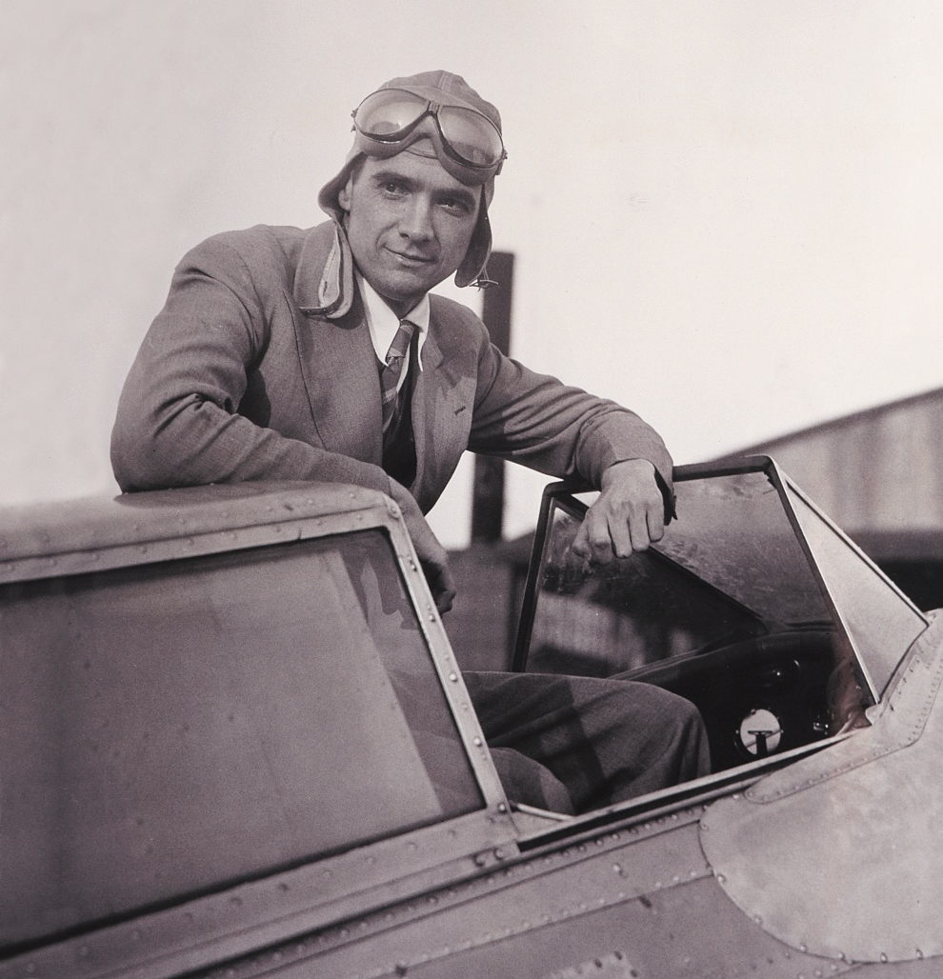
Howard Hughes Medical Institute
A science philanthropy whose mission is to advance biomedical research and science education for the benefit of humanity.
$7.1 billion invested in research and science education since 2003
$695 million for research and research support in 2012
$114 million for science education, international research in 2012
Current endowment of $16.1 billion

Slide 2
HHMI Board of Trustees
Kurt L. Schmoke, Esq., Chairman. Dean, Howard University School of Law
James A. Baker, III, Esq., Senior Partner, Baker Botts L.L.P.; former U.S. Secy. of State
Ambassador Charlene Barshefsky, Esq.,Senior International Partner Wilmer Hale
Susan Desmond-Hellman, M.D.,M.P.H., Chancellor, University of California, San Francisco
Joseph L. Goldstein, M.D., Regental Professor and Chairman, Department of Molecular Genetics, University of Texas Southwestern Medical Center at Dallas
Garnett L. Keith, Chairman,SeaBridge Investment Advisors, L.L.C.; Former Vice Chairman
and Chief Investment Officer, The Prudential Insurance Company of America
Fred R. Lummis, Chairman and CEO, Platform Partners LLC
Sir Paul Nurse, F.R.S., President, The Royal Society, Director,The Francis Crick Institute
Dame Alison Richard, Ph.D., Senior Research Scientist and Professor Emerita, Yale University
Clayton S. Rose, Ph.D., Senior Lecturer of Business Administration, Harvard University;
Former Head of Global Investment Banking, J.P. Morgan & Co.
Anne M. Tatlock, Director, Retired Chairman and CEO, Fiduciary Trust Company International

Slide 3
Senior Scientific Leadership
Robert Tjian, Ph.D.
President, HHMI
and
Professor of Biochemistry &
Molecular Biology
University of California-Berkeley
Erin O’Shea, Ph.D.
Vice President and Chief Scientific
Officer, HHMI
and
Paul C. Mangelsdorf Professor,
Molecular and Cellular Biology,
and Chemistry and Chemical Biology
Harvard University
Gerald M. Rubin, Ph.D.
Vice President and Director, Janelia Farm Research Campus
Sean Carroll, Ph.D.
Vice President for Scientific Education, HHMI
and
Allan Wilson Professor of Molecular
Biology, Genetics, and Medical Genetics
University of Wisconsin-Madison

Slide 4
Medical Advisory Board: A Committee Guiding Scientific Review and Policy
David Baltimore, Ph.D.
President Emeritus and Robert Andrews Millikan Professor of Biology
California Institute of Technology
J. Michael Bishop, M.D.
Director, G.W. Hooper Foundation and University Professor
University of California, San Francisco
Michael Botchan, Ph.D.
Richard and Rhoda Goldman Distinguished Professor of Biochemistry and Co-Chair of the Department of Molecular and Cell Biology
University of California, Berkeley
Gerry Fink, Ph.D.
Herman and Margaret Sokol Professor
Whitehead Institute for Biomedical Research
Massachusetts Institute of Technology
Carol Greider, Ph.D.
Daniel Nathans Professor & Director Molecular Biology & Genetics
Johns Hopkins University School of Medicine
Rowena Matthews, Ph.D.
G. Robert Greenberg Professor Emeritus of Biological Chemistry
and Research Professor Emeritus, Life Sciences Institute
University of Michigan
Elizabeth Nabel, M.D.
President
Brigham and Women's/Faulkner Hospitals, Boston
Janet Rossant, Ph.D., F.R.S.
University Professor of Molecular Genetics and of
Obstetrics and Gynecology, University of Toronto
Chief of Research
The Hospital for Sick Children, Toronto
Phillip Sharp, Ph.D.
Institute Professor, Koch Institute for Integrative Cancer Research
Massachusetts Institute of Technology
Bruce Stillman, Ph.D., F.R.S.
President, Cold Spring Harbor Laboratory
Marc Tessier-Lavigne, Ph.D.
President, The Rockfeller University
Craig Thompson, M.D.
President and Chief Executive Officer
Memorial Sloan-Kettering Cancer

Slide 5
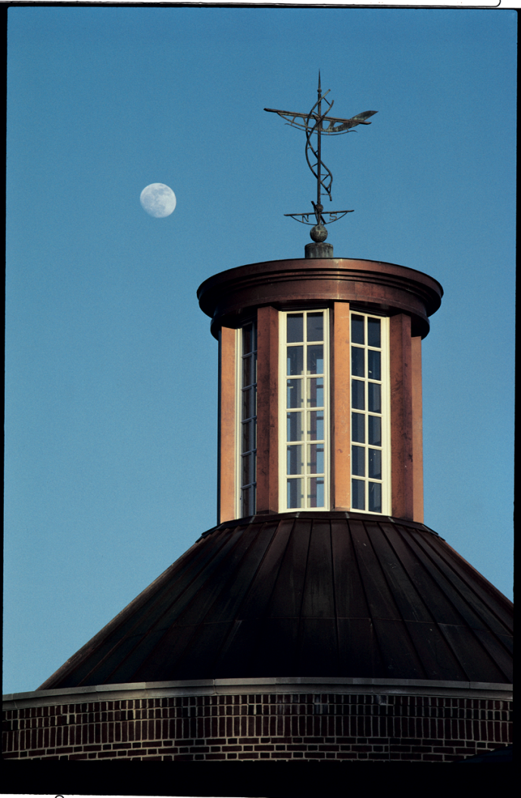
HHMI’s Major Programs
HHMI Investigators and Early Career Scientists
Janelia Farm Research Campus
International Research
Science Education

Slide 6
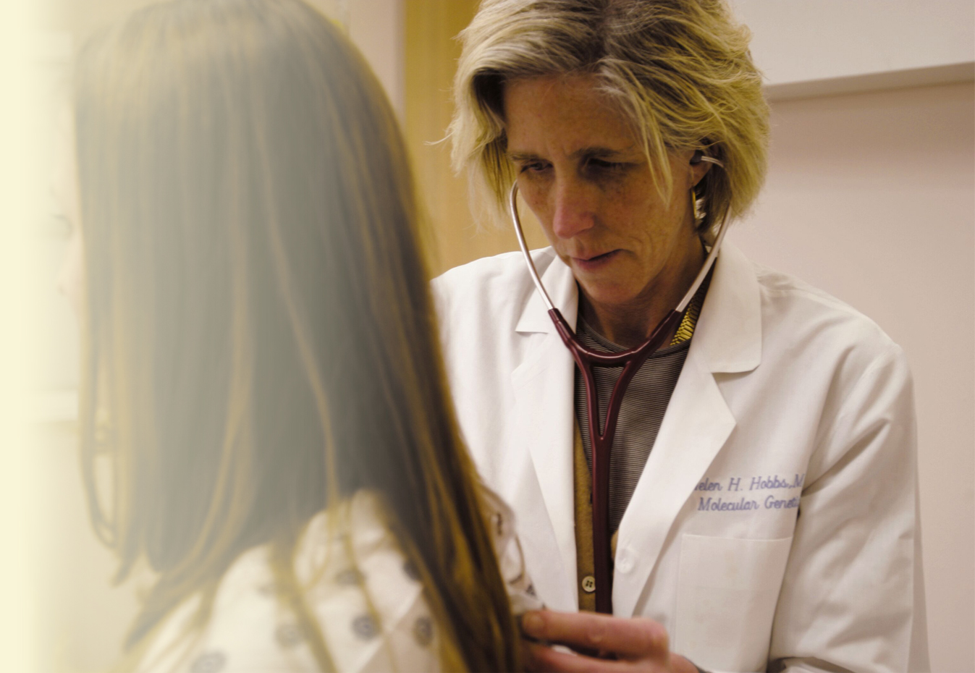
HHMI Investigator Program
“People, not projects”
Transforming discoveries
High risk, high reward
Flexible, generous funding,

Slide 7
HHMI Investigator Program
Science department budget: ~$650M/year (exclusive of Janelia Farm)
~$1.4M per investigator, although the individual amounts vary
312 Investigators (12 others to be appointed in 2013)
40 Early Career Scientists
41 Janelia Farm Laboratory Groups
70 Host Institution Sites + Janelia Farm Campus

Slide 8
Strategies to maximize an HHMI investigator’s impact
1. “People, not projects” - promote freedom to focus on projects driven by passion,
incentive to emphasize creativity and a sense of responsibility to harness resources to
study risky but high-impact questions
Minimize non-research requirements; 75% of time to be spent on
“active conduct of research”
Provide extensive administrative, legal, operational and scientific assistance
Provide complete salary and benefits for investigators and other employees
Investigator controls generous budgets for laboratory personnel and supplies
Investigators can apply for equipment purchases during four rounds of
capital funding annually
8. Annual scientific meetings foster critical review and scientific collaborations

Slide 9
Current Investigators Year of Award
Susumu Tonegawa 1987
Thomas Cech 1989
Eric Wieschaus 1995
Gunter Blobel 1999
Eric Kandel 2000
Robert Horvitz 2002
Roderick MacKinnon 2003
Linda Buck 2004
Richard Axel 2004
Craig Mello 2006
Mario Capecchi 2007
Roger Tsien 2008
Jack Szostak 2009
Thomas Steitz 2009
Robert Lefkowitz 2012
Randy Shekman 2013
Thomas Sudhof 2013
And six alumni investigators

Slide 10
Members of the National Academy of Science
(NAS)
as of 2013: 172 (out of 354 investigators and early career scientists)
since 1994, HHMI investigators accounted for approximately
19% of all new NAS members in the Life Sciences
65 members of the Institute of Medicine

Slide 11
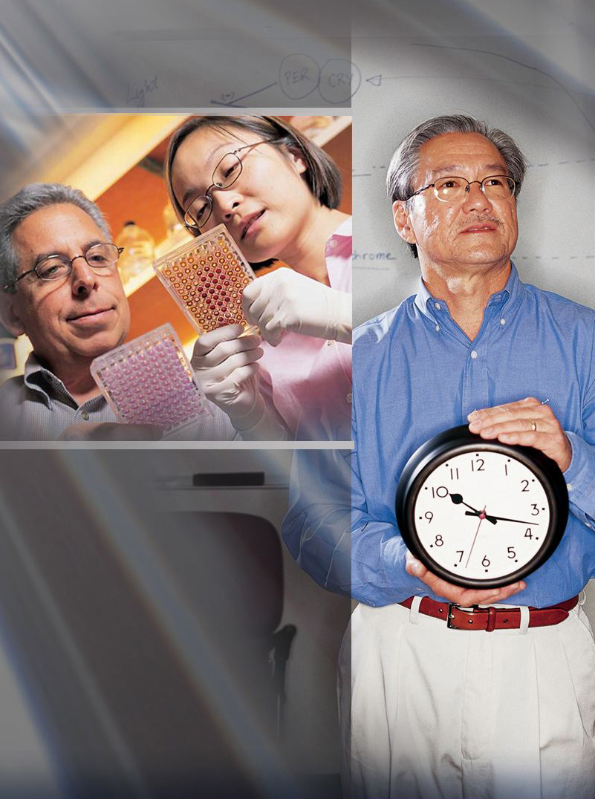
A Model That Fosters Invention
2,477 inventions
1,270 active licenses
1,242 patents
976 pending patent applications
100+ startup companies
As of 2012

Slide 12
Reviewing the HHMI Investigator
Does Our Review Process Retain Only the Best People?
“The most important single task that Jack Dixon and I have at HHMI is to review the
reviewers.”
Robert Tjian, President of HHMI

Slide 13
What are the criteria for an investigator review?
“The Howard Hughes Medical Institute expects not only that its investigators be talented
and productive scientists, but also that they demonstrate some combination of the following
attributes to an extent that clearly distinguishes them from other highly competent researchers
in their field:
(1) They identify and pursue significant biological questions in a rigorous and deep manner.
(2) They push their chosen research field into new areas of inquiry, being consistently at
its forefront.
(3) They develop new tools and methods that enable creative experimental approaches to
biological questions, bringing to bear, when necessary, concepts or techniques from
other disciplines.
(4) They forge links between basic biology and medicine.
(5) They demonstrate great promise of future original and innovative contributions.”

Slide 14
Scientific Review
The Review Process
Reviews take place every 5 years; no review for ECS (a six year appointment)
All reviewer panel votes are counted for each investigator
No progress reports are required between formal reviews
The Reviewers:
A mixture of experts in a specific field and “knowledgeable generalists”
Especially important to include skilled evaluators of scientific talent
Members of the Scientific Review Board, Medical Advisory Board and ad hoc distinguished scientists (No HHMI Investigators participate in the review)

Slide 15
HHMI Investigator Reviews Materials Submitted in Advance of the Review Meeting
Curriculum vitae.
Bibliography, in reverse chronological order
Information about all graduate students and postdoctoral fellows affiliated with the investigator’s research group during the past 10 years
Description of research performed during the current appointment term, as well as a description of future goals and plans
PDF’s of the five most significant publications during the current appointment term, and a statement describing the impact and significance of each publication
Investigators are encouraged to update their laboratory web site as well as their HHMI public web site pages, well in advance of the review.

Slide 16
Review Meeting - at HHMI Headquarters in Chevy Chase, Maryland
Investigator Presentation – 35 minutes
Questions and Discussion – 20 minutes
Executive Session and Development of Recommendation for Appointment
Final Decision made by HHMI Science Department and the President
For Reappointment for a Renewable Five-Year Term
Or Nonrenewable Appointment for a Two-Year Term

Slide 17
Investigator Review Outcomes: 2000 – 2012
Year | # Reviews | # Terminated | % Terminated
2000 | 28 | 5 | 18
2001 | 36 | 7 | 19
2002 | 65 | 17 | 26
2003 | 67 | 16 | 24
2004 | 74 | 14 | 19
2005 | 58 | 6 | 10
2006 | 30 | 4 | 13
2007 | 60 | 7 | 12
2008 | 41 | 10 | 24
2009 | 48 | 10 | 21
2010 | 60 | 12 | 20
2011 | 59 | 10 | 17
2012 | 44 | 14 | 31
Total | 670 | 132 | 20

Slide 18
2012: length of HHMI appointment periods
80
Male
70
Female
60
50
Investigators
40
30
20
10
<5
5-9
10-14
15-19
20-24
25-29
30-34
# of Years

Slide 19
