Slide 1
SMRB STEM Charge
ATTACHMENT 8
December 18, 2013
Lawrence A. Tabak, DDS, PhD
Principal Deputy Director
Department of Health and Human Services
r, NIH

Slide 2
Science, Technology, Engineering, and Math (STEM)
Introduction and Challenges
National Effort to Coordinate STEM Programs
NIH STEM Programs
SMRB Charge
Notes:
Pipeline; mentoring; infrastructure; fairness of peer review

Slide 3
Science, Technology, Engineering, and Math (STEM)
Introduction and Challenges
National Effort to Coordinate STEM Programs
NIH STEM Programs
SMRB Charge
Notes:
Pipeline; mentoring; infrastructure; fairness of peer review

Slide 4
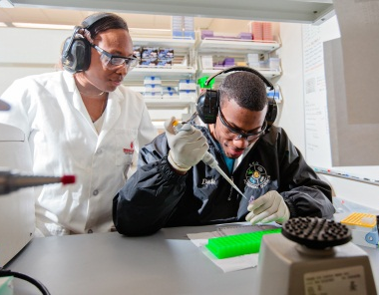
Science, Technology, Engineering, and Mathematics (STEM)
STEM typically includes educational activities across all grade levels—from pre-school to post-doctorate—in both formal and informal settings
Inventories of STEM programs are complex because no precise definition of what constitutes a STEM education program or activity exists
U.S. agencies with STEM programs define the fields encompassed by STEM differently. For example:
NSF includes psychology and social sciences (e.g., political science and economics)
DHS only include “core” sciences (e.g., physics, chemistry, and math) and engineering

Slide 5
Science, Technology, Engineering, and Mathematics (STEM)
Federal interest in science and technology literacy dates back to George Washington, but the launch of the Sputnik satellite in 1957 catapulted STEM to the forefront of U.S. education policy
More recent U.S. concerns about STEM focus on the essential role that a STEM-educated and STEM-trained workforce plays in the competitive global economy
Testing indicates that U.S. students are being outperformed by many other countries in STEM

Slide 6
U.S. Students Lag Globally in STEM
In 2012, the Programme for International Student Assessment (PISA) conducted an assessment of 15 year olds in reading, math, and science in 65 countries and economies
Among the 34 Organization for Economic Co-operation and Development (OECD) countries, the U.S. performed below average in math and is ranked approximately 26th
U.S. performance in reading and science was about average among OECD countries
While the U.S. spends far more per student than most countries, this does not translate to better performance
Despite investments of $3 billion per year in STEM education, PISA trend data show no significant changes in performance over time
Notes:
The following departments and agencies are represented on the CoSTEM:
Department of Agriculture;
Department of Commerce;
Department of Defense;
Department of Education;
Department of Energy;
Department of Health and Human Services;
Department of the Interior;
Department of Transportation;
Environmental Protection Agency;
National Aeronautics and Space Administration; and
National Science Foundation.
The following organizations in the Executive Office of the President are also represented on the CoSTEM:
Domestic Policy Council;
National Economic Council;
Office of Management and Budget;
Office of Science and Technology Policy

Slide 7
STEM Investment in Other Countries
Other countries are investing in STEM programs to reinforce the pipeline to train a strong biomedical workforce
For example, Singapore focuses its support on training individuals to prepare them for careers in industry or to work in hospitals
The government also provides support to schools to encourage young people (from the youngest ages) to go into science
The UK houses STEM teaching and learning resources in the National STEM Centre to provide teachers of STEM subjects with support materials. The STEM Centre also works with business, industry, charitable organizations, and professional societies to facilitate collaboration and promotion of STEM career awareness

Slide 8
U.S. Students Lag Globally in STEM: Impacts on the Biomedical Workforce
Failure to foster a strong foundation in STEM education among U.S. students will have ripple effects on the biomedical workforce
A steady stream of students entering science education tracks at a young age is essential to feeding the pipeline with individuals inclined to pursue careers in biomedical science
Strong, evidence-based STEM programs at all points along the career path is vital for training a strong biomedical workforce
Without a strong biomedical workforce, NIH will be unable to fulfill its mission and U.S. global competitiveness will falter

Slide 9
Science, Technology, Engineering, and Math (STEM)
Introduction and Challenges
National Effort to Coordinate STEM Programs
NIH STEM Programs
SMRB Charge
Notes:
Pipeline; mentoring; infrastructure; fairness of peer review

Slide 10
National Effort to Coordinate STEM Programs: Committee on STEM Education (CoSTEM)
CoSTEM was established in 2010 by the National Science and Technology Council to coordinate Federal STEM programs and activities
CoSTEM consists of a wide spectrum of members from Federal departments, agencies, councils, and offices
Functions:
Ensure effectiveness of STEM education activities and programs
Coordinate STEM education activities and programs with the Office of Management and Budget
Develop and implement through the participating agencies a 5-year STEM education strategic plan, to be updated every 5 years
Notes:
The following departments and agencies are represented on the CoSTEM:
Department of Agriculture;
Department of Commerce;
Department of Defense;
Department of Education;
Department of Energy;
Department of Health and Human Services;
Department of the Interior;
Department of Transportation;
Environmental Protection Agency;
National Aeronautics and Space Administration; and
National Science Foundation.
The following organizations in the Executive Office of the President are also represented on the CoSTEM:
Domestic Policy Council;
National Economic Council;
Office of Management and Budget;
Office of Science and Technology Policy

Slide 11
Federal Agencies with STEM Programs
Notes:
The following departments and agencies are represented on the CoSTEM:
Department of Agriculture;
Department of Commerce;
Department of Defense;
Department of Education;
Department of Energy;
Department of Health and Human Services;
Department of the Interior;
Department of Transportation;
Environmental Protection Agency;
National Aeronautics and Space Administration; and
National Science Foundation.
The following organizations in the Executive Office of the President are also represented on the CoSTEM:
Domestic Policy Council;
National Economic Council;
Office of Management and Budget;
Office of Science and Technology Policy

Slide 12
WHAT IS NIH’S UNIQUE ROLE?
Notes:
The following departments and agencies are represented on the CoSTEM:
Department of Agriculture;
Department of Commerce;
Department of Defense;
Department of Education;
Department of Energy;
Department of Health and Human Services;
Department of the Interior;
Department of Transportation;
Environmental Protection Agency;
National Aeronautics and Space Administration; and
National Science Foundation.
The following organizations in the Executive Office of the President are also represented on the CoSTEM:
Domestic Policy Council;
National Economic Council;
Office of Management and Budget;
Office of Science and Technology Policy

Slide 13
NIH Mission and Goals
NIH’s mission to seek fundamental knowledge about the nature and behavior of living systems and the application of that knowledge to enhance health, lengthen life, and reduce illness and disability is supported by the following goals:
to foster fundamental creative discoveries, innovative research strategies, and their applications as a basis for ultimately protecting and improving health;
to develop, maintain, and renew scientific human and physical resources that will ensure the Nation's capability to prevent disease
to expand the knowledge base in medical and associated sciences in order to enhance the Nation's economic well-being and ensure a continued high return on the public investment in research; and
to exemplify and promote the highest level of scientific integrity, public accountability, and social responsibility in the conduct of science.

Slide 14
Biomedical Workforce Pipeline
Growing concerns about waning interest in science among young people
Long training times and relatively low early-career salaries when compared to other scientific disciplines and professional careers may make the biomedical research career less attractive to young people
Launching a traditional, independent, academic research career is increasingly difficult
Current training programs do little to prepare people for anything besides an academic research career, despite clear evidence that a declining percentage of graduates find such positions in the future

Slide 15
Science, Technology, Engineering, and Math (STEM)
Introduction and Challenges
National Effort to Coordinate STEM Programs
NIH STEM Programs
SMRB Charge
Notes:
Pipeline; mentoring; infrastructure; fairness of peer review

Slide 16
NIH STEM Programs
NIH is uniquely responsible for training and retaining the biomedical research workforce
STEM education is an important element in both attracting people to, and preparing people for, careers in biomedical research
It is also important to the mission of NIH that the general public is scientifically literate
The U.S. government is grappling with how best to improve STEM education programs and the pipeline, and NIH must identify its role given its unique mission to support and conduct biomedical research

Slide 17
Examples of NIH STEM Efforts
Science Education Partnership Awards (SEPA) - OD
Development and evaluation of innovative research education programs to improve pre-K-12 understanding of biomedical research and provide insights into biomedical research career opportunities
NIH will present a new concept clearance about SEPA to the Council of Councils early in 2014 and obtain their input on best ways to enhance SEPA
We anticipate issuing a new funding opportunity for FY 2015 SEPA programs
Notes:
Office of Science Education
Curriculum supplements for K-12 science teachers
Supplements can be freely accessed online

Slide 18
Examples of NIH STEM Efforts (cont.)
NIH Summer Research Experience Programs
Provides high quality research experiences for college students and for science teachers during the summer academic break
Encourages young students to consider careers in science, gain valuable research experience to prepare for graduate school
Aids science teachers in effectively communicating the nature of the scientific process to their students
Notes:
Office of Science Education
Curriculum supplements for K-12 science teachers
Supplements can be freely accessed online

Slide 19
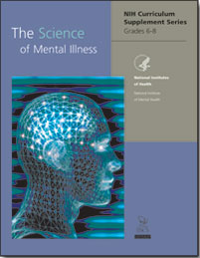
Examples of NIH STEM Efforts (cont.)
Notes:
NIH Curriculum Supplement Series targets students in:
Elementary school
Middle school
High school

Slide 20
Examples of NIH STEM Efforts (cont.)
Teacher’s guide
NIDA has developed “Mind Over Matter” booklets that follow the scientific research activities of a young scientist, Sara Bellum. Teens learn about the brain’s complex responses to drugs, including cocaine, hallucinogens, inhalants, marijuana, nicotine, opiates, prescription drugs, and steroids.
Notes:
NIDA literature aimed at teens

Slide 21
Science, Technology, Engineering, and Math (STEM)
Introduction and Challenges
National Effort to Coordinate STEM Programs
NIH STEM Programs
SMRB Charge
Notes:
Pipeline; mentoring; infrastructure; fairness of peer review

Slide 22
Charge to the SMRB Working Group on NIH STEM Programs
The SMRB is charged with recommending ways to optimize NIH’s STEM programs and initiatives that both align with the NIH mission and ensure a continued pipeline of STEM-educated students and professionals.

Slide 23
Charge to the SMRB Working Group on NIH STEM Programs (cont.)
In addressing this charge, the SMRB should:
Study previous and current Federal STEM education efforts, particularly in the life sciences
Review an inventory of NIH STEM activities
Assess, at a high level, the effectiveness and impacts of NIH’s STEM activities

Slide 24
Charge to the SMRB Working Group on NIH STEM Programs (cont.)
In addressing this charge, the SMRB should:
Define principles to guide future NIH efforts in evidence-based STEM programs and initiatives
Identify attributes, activities, and components of effective STEM programs
Determine how to augment the evidence base for identifying successful approaches for STEM programs and for monitoring and adjusting STEM activities

Slide 25
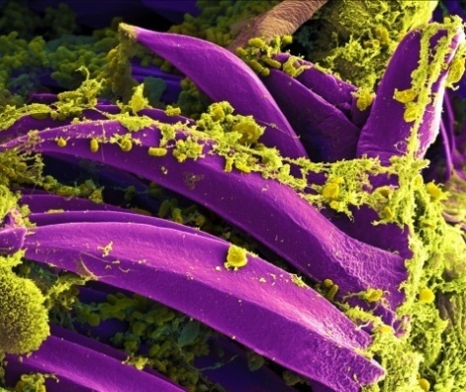
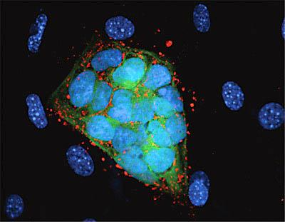
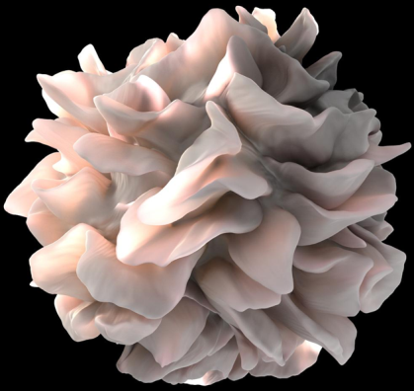
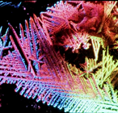
NIH…
Lawrence.Tabak@nih.gov
Turning Discovery Into Health

