Slide 1
Recent NIH Activities: A Brief Update
NIH Scientific Review Board Meeting
October 24, 2013
Lawrence Tabak, D.D.S., Ph.D.
Principal Deputy Director, NIH
Department of Health and Human Services

Slide 2
Furthering the NIH Mission
Enhancing the translation of data into knowledge
Big Data to Knowledge (BD2K)
Reproducibility activities and pilot programs
Accelerating development of in-depth understanding of human brain
BRAIN Initiative
Ensuring a robust and diverse biomedical workforce
Biomedical Workforce and Diversity Initiatives
Supporting the best science through a dynamic and efficient peer review system

Slide 3
Furthering the NIH Mission
Enhancing the translation of data into knowledge
Big Data to Knowledge (BD2K)
Reproducibility activities and pilot programs
Accelerating development of in-depth understanding of human brain
BRAIN Initiative
Ensuring a robust and diverse biomedical workforce
Biomedical Workforce and Diversity Initiatives
Supporting the best science through a dynamic and efficient peer review system

Slide 4
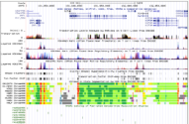
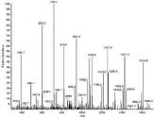
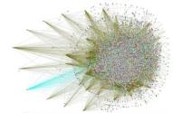
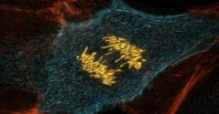
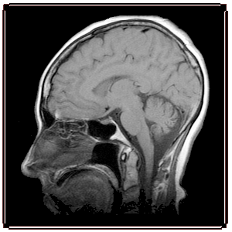
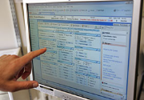
Myriad Data Types
Genomic
Other ‘Omic
Imaging
Phenotypic
Exposure
Clinical
Notes:
Within biomedical research, many data types
Victims of our own success
Data production outstrips data handling and analysis
Major long-term changes are needed

Slide 5
Daily Users - NCBI Web Site
Notes:
For over 30 years, NIH has implemented policies and systems to ensure the knowledge and data generated from its research investments was archived & accessible.
This has created the opportunity for Big Data discovery in biomedical research

Slide 6
Data and Informatics Working Group of Advisory Committee to the NIH Director
Major Themes in Report:
At a pivotal point:
At risk of failing to capitalize on technology advances
Cultural changes at NIH are essential
Aim to develop new opportunities for:
Data sharing
Data analysis
Data integration
Long-term NIH commitment is required
acd.od.nih.gov/diwg.htm
Notes:
Data and Informatics Working Group established in early 2011
Report delivered in June 2012

Slide 7
NIH is Tackling the “Big Data” Problem
New NIH Leadership Position:
Associate Director for Data Science
2. New Internal NIH Governing/Oversight Body:
Scientific Data Council
3. New Trans-NIH Initiative:
Big Data to Knowledge

Slide 8
Furthering the NIH Mission
Enhancing the translation of data into knowledge
Big Data to Knowledge (BD2K)
Reproducibility activities and pilot programs
Accelerating development of in-depth understanding of human brain
BRAIN Initiative
Ensuring a robust and diverse biomedical workforce
Biomedical Workforce and Diversity Initiatives
Supporting the best science through a dynamic and efficient peer review system

Slide 9
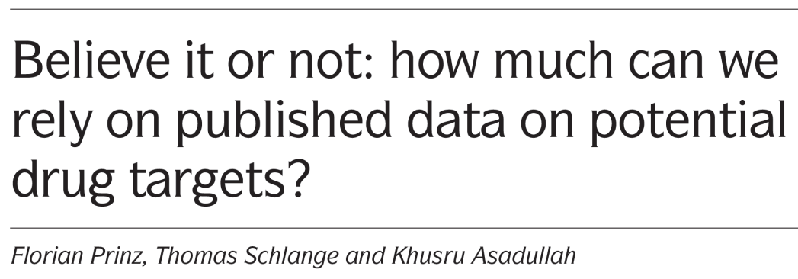
Courtesy of Dr. S. Silberberg, NINDS

Slide 10
Reproducibility and Transparency of Research Findings
Reproducibility and transparency of research findings have been noted as an issue in multiple publications.
This is a problem in all areas of research, not just specific types of studies.
This has also been observed in both clinical and preclinical research, though the focus here is on reproducibility of preclinical research.
Notes:
Approach
For each study section, count the number of new (type 1), original (A0) unsolicited R01 applications received and the number awarded from FY 2008 to FY 2012
Normalize these figures by dividing by the total number of unique investigators that applied to each study section in each fiscal year
Include investigators submitting any unsolicited competing R01 application and all “contact” and co-Pis
Results in:
The number of new, original applications per person per year for each study section
Create a scatter plot with applications per person per year on the x-axis and awards per person per year on the y-axis, centered at the overall average application and award rates for all study sections

Slide 11
Background
Topic discussed in workshops by NINDS and NCI in 2012.
IC leadership supportive of further focus on reproducibility.
Ad-hoc group formed by Francis Collins to develop approaches to redressing these issues.
Group’s deliberations brought to IC Directors for feedback.
IC Director input used to inform plans for Trans-NIH and IC-level next steps.

Slide 12
Underlying Issues
Poor training
Poor evaluation
Perverse reward incentives

Slide 13
Principles for Addressing the Underlying Issues
Raise community awareness.
Enhance formal training.
Improve the evaluation of applications.
Protect the quality of funded and published research by adoption of more systematic review processes.
Increase stability for investigators.

Slide 14
Trans-NIH Actions and Pilots
ICs and OD Offices will discuss reproducibility and transparency of research findings with their stakeholder communities to alert them to the issues and solicit feedback.
OIR to create and pilot a new module on research integrity as it relates to experimental biases and study design to ethics training course required for NIH intramural fellows.
Once tested, OER will make available on the web and encourage adoption (or equivalent) by extramural training programs for fellows and trainees.
Notes:
Stakeholder outreach: ICs have already started, and in that vein, LAT has presented to 4 Advisory Councils about this issue.

Slide 15
Trans-NIH Actions and Pilots (cont.)
Pilots will be conducted by ICs
Evaluation process of the “scientific premise” of a grant application
Checklist to systematically evaluate grant applications
Changes to bio-sketch
Approaches to reduce “perverse incentives”
Supporting replication studies
Convene meetings with Journal Editors, Study Section Chairs, and BSC Chairs
Notes:
Stakeholder outreach: ICs have already started, and in that vein, LAT has presented to 4 Advisory Councils about this issue.

Slide 16
Furthering the NIH Mission
Enhancing the translation of data into knowledge
Big Data to Knowledge (BD2K)
Reproducibility activities and pilot programs
Accelerating development of in-depth understanding of human brain
BRAIN Initiative
Ensuring a robust and diverse biomedical workforce
Biomedical Workforce and Diversity Initiatives
Supporting the best science through a dynamic and efficient peer review system

Slide 17
Brain Disorders Affect Us All
Neurodegenerative disorders
Alzheimer’s, Parkinson’s, ALS, Huntington’s…
Annual cost of dementia care in the U.S. is ~200 billion
Cognitive and affective disorders
Schizophrenia, Bipolar Disorder, Depression, Anxiety, OCD…
Neurodevelopmental disorders
Autism, Attention-deficit disorder, Epilepsy, Intellectual disability…
Injury- and insult-induced disorders
PTSD, Traumatic brain injury, Stroke…

Slide 18
BRAIN Initiative: Goals
Accelerate development, application of innovative technologies to construct dynamic picture of brain function that integrates neuronal and circuit activity over time and space
Build on growing scientific foundation – neuroscience, genetics, physics, engineering, informatics, nanoscience, chemistry, mathematics, etc. – to catalyze interdisciplinary effort of unprecedented scope

Slide 19
BRAIN Working Group Interim Report: High-Priority Research Areas for FY14
Generate a census of cell types
Create structural maps of the brain
Develop new large-scale network recording capabilities
Develop a suite of tools for circuit manipulation
Link neuronal activity to behavior
Integrate theory, modeling, statistics, and computation with experimentation
Delineate mechanisms underlying human imaging technologies
Create mechanisms to enable collection of human data
Disseminate knowledge and training

Slide 20
Furthering the NIH Mission
Enhancing the translation of data into knowledge
Big Data to Knowledge (BD2K)
Reproducibility activities and pilot programs
Accelerating development of in-depth understanding of human brain
BRAIN Initiative
Ensuring a robust and diverse biomedical workforce
Biomedical Workforce and Diversity Initiatives
Supporting the best science through a dynamic and efficient peer review system

Slide 21
Biomedical Research Workforce: Challenges
Increasingly difficult to launch traditional, independent academic research career:
Rising number of Ph.D.s
Number of established researchers staying longer in field
Long training time and relatively low early-career salaries make biomedical research careers less attractive than other professions
Training programs offer little preparation for careers outside academia–despite decreasing likelihood of finding an academic position
http://acd.od.nih.gov/bwf.htm

Slide 22
DP7 BEST Program – Broadening Experiences in Scientific Training
Common Fund program seeking innovative approaches to complement traditional research training in biomedical sciences at institutions that receive NIH funds
http://grants.nih.gov/grants/guide/rfa-files/RFA-RM-12-022.html
One application per institution
Up to $250,000 in direct costs per year
Closed May 10, 2013
Over 100 applications
Awards were announced on September 23 - http://www.nih.gov/news/health/sep2013/od-23.htm
Encourage institutions to leverage funds with existing institutional offices and programs, local resources outside the institution, or that partner with industry or other entities
Must include rigorous analysis to demonstrate impact
Proven approaches will be widely disseminated throughout the biomedical research community; awardees will meet to exchange ideas

Slide 23
Other Workforce Initiatives
Improve graduate student and postdoctoral training
Increase postdoctoral stipends – to be implemented in FY2014
Consider policies on benefits – developing comprehensive survey
Shorten eligibility period and increase support for K99/R00 – implemented for applications received after February 2014
Develop a simple and comprehensive tracking system for trainees
Automate training grant tables to include structured data
Develop SciENCV
Incorporate unique identifier
Initiate discussion with the community to assess NIH support of faculty salary – developing pilot survey
Create functional unit at NIH to assess the biomedical research workforce

Slide 24
Diversity: The Challenges We Must Solve
http://acd.od.nih.gov/06142012_DBR_ExecSummary.pdf

Slide 25
Diversity: The Challenges We Must Solve
Time: no one set of initiatives will diversify NIH-funded workforce overnight
Mistrust: we must gain trust within many communities
Develop partners: success will require collaboration and cooperation of extramural partners
Diversifying the NIH-funded workforce and ensuring the fairness of the peer review system are collective responsibilities across NIH

Slide 26
Diversity Initiative: Overarching Strategy
Four interrelated approaches will be implemented:
NIH Building Infrastructure Leading to Diversity (BUILD) Program
National Research Mentoring Network (NRMN)
Ensuring Fairness in Peer Review
Increased Engagement by all NIH Leadership – Create Steering Committee WG on Diversity and Recruit Chief Officer for Scientific Workforce Diversity

Slide 27
Furthering the NIH Mission
Enhancing the translation of data into knowledge
Big Data to Knowledge (BD2K)
Reproducibility activities and pilot programs
Accelerating development of in-depth understanding of human brain
BRAIN Initiative
Ensuring a robust and diverse biomedical workforce
Biomedical Workforce and Diversity Initiatives
Supporting the best science through a dynamic and efficient peer review system

Slide 28
Improving the NIH Systems for Reviewing and Awarding Grants
Brief Background on Peer Review
Ongoing Efforts
New Charge to the SMRB

Slide 29
Improving the NIH Systems for Reviewing and Awarding Grants
Brief Background on Peer Review
Origins, Scope, and Core Values
Ongoing Efforts
New Charge to the SMRB

Slide 30
NIH Review and Award Process: Fundamental to the NIH Mission
The NIH two-tier review system is the foundation on which the agency’s funding of extramural research is based.
The majority of the NIH budget goes to extramural research grants.
It is vital that NIH continue to innovate and optimize the process by which grant applications are submitted, reviewed, processed, and awarded.

Slide 31
NIH Review and Award Process: Scope of NIH Peer Review
Each year, NIH:
Issues 1,000 – 1,100 Funding Opportunity Announcements
Reviews 70,000 – 80,000 applications
Recruits ~22,500 reviewers (average = two review meetings per reviewer)
Runs ~2500 meetings

Slide 32
NIH Review and Award Process: Origins of NIH Peer Review
The Public Health Service Act (Sec. 492 [289a]) requires the technical and scientific peer review of applications for grants and contracts
Requires the reviewing entity be provided with a written description of the research under review
The reviewing entity provides the advisory council with this description and the results of the review

Slide 33
NIH Review and Award Process: Origins of NIH Peer Review (cont.)
Federal regulation at 42 CFR 52h “Scientific Peer Review of Research Grant Applications and Research and Development Contract Projects”
Invokes the Federal Advisory Committee Act
Defines the membership of review groups and expertise
Defines conflicts of interest for reviewers
Outlines review criteria for research projects

Slide 34
NIH Review and Award Process: Core Values of NIH Peer Review
Expert assessment
Transparency
Impartiality
Fairness
Confidentiality
Integrity
Efficiency
*See NIH Peer Review: Grants and Cooperative Agreements

Slide 35
Continuous Review of Peer Review
http://enhancing-peer-review.nih.gov/docs/Enhancing_Peer_Review_Report_2012.pdf

Slide 36
Continuous Review of Peer Review (cont.)
ACD Working Group on
Diversity in the Biomedical Research Workforce
NIH should establish a WG of the ACD comprised of experts in behavioral and social sciences and studies of diversity with a special focus on determining and combating real or perceived biases in the NIH peer review system (Recommendation #9)
NIH should first, pilot different forms of validated implicit bias/diversity awareness training for NIH scientific review officers and program officers to determine the most efficacious approaches. Once the best training approaches have been identified with NIH staff, pilot these programs with members of study sections to ascertain if their value is sustained. If they are, provide to all study section members (Recommendation #10)
http://acd.od.nih.gov/06142012_DBR_ExecSummary.pdf

Slide 37
Improving the NIH Systems for Reviewing and Awarding Grants
Brief Background on Peer Review
Ongoing efforts
Develop new approaches for ensuring that NIH peer review is a dynamic process responsive to important and emerging scientific trends and opportunities
New charge to the SMRB

Slide 38
Current NIH Efforts to Enhance the Responsiveness of Peer Review to Emerging Scientific Opportunity
In January 2013, the NIH Director convened a team of NIH experts to:
Develop methods for identifying emergent, highly active, areas of science as well as those areas that may have stagnated
Recommend approaches for coupling the “state” of scientific fields with study section organization in order to yield a dynamic system responsive to scientific trends

Slide 39
Improving the NIH Systems for Reviewing and Awarding Grants
Brief Background on peer review
Ongoing effort
New charge to the SMRB
Complementary to, but distinct from, the ongoing effort
Will need to ensure that both groups are kept abreast of each other’s activities
Focused on streamlining and shortening the process while maintaining high quality review

Slide 40
NIH Review and Award Process: Challenges and Opportunities
Today, the research enterprise faces additional challenges due to economic constraints that have resulted in decreases in application success rates
At the same time, advances in technology may be capitalized on to improve overall efficiency and effectiveness in the grant awarding process

Slide 41
NIH Review and Award Process: Charge to the SMRB
NIH requests that the SMRB recommend ways to further optimize the process of reviewing and awarding grants.
In addressing this charge, the scope of the SMRB deliberations should focus on ways in which NIH can:
Streamline the grant-making process and shorten the length of time from application to allocation of funds, and
Address the administrative burden on applicants and their institutions, scientific reviewers, Council members, and NIH staff while maintaining a high-quality review process

Slide 42
NIH Review and Award Process: Charge to the SMRB (cont.)
NIH requests that the SMRB provide:
Recommended strategies and options for improving the process (i.e., streamlining procedures, shortening time frames, reducing burden) as well as the rationale for these recommendations

Slide 43
Discussion

