Slide 1
Address to NIH
Scientific Management Review Board
Presented by
Philip Yeo, SINGAPORE
Chairman, Standards, Productivity and Innovation for Growth
SPRING, www.spring.gov.sg, 2007-to-date
Chairman, Agency for Science, Technology and Research
A*STAR, www.a-star.edu.sg, 2001-2007)
Chairman, Economic Development Board
EDB, www.edb.gov.sg, 1986-2006

Slide 2
Measuring the Impact and
Value of Biomedical Research
Industrial Capital – Promote Economic Growth
Knowledge Capital – Encourage Scientific Excellence and Innovation - Encourage Networks/Collaboration in the Research Community
Clinical and Healthcare Capital – Support Clinical Trials and Healthcare Outcomes
Human Capital – Invest in and Nurture R&D Talent
Communications: Value of Scientific Knowledge to Economic Growth

Slide 3
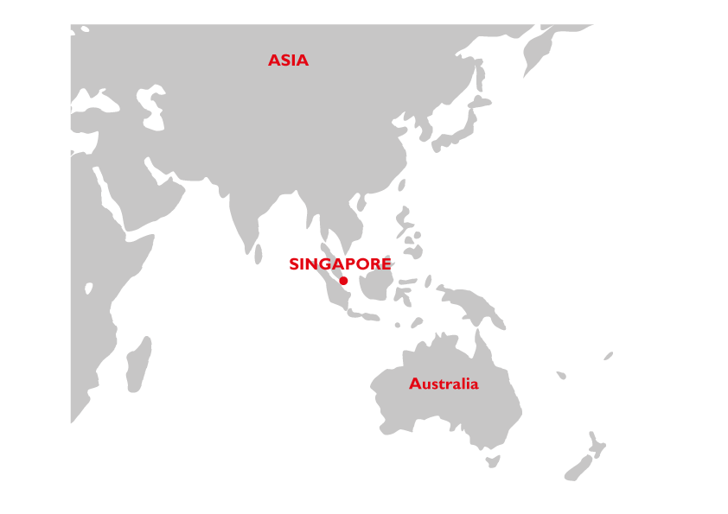
Growth of Singapore’s Economy
2012 GDP:
US$276.5 billion
2012 Per
Capita GDP:
US$52,000
First National
Technology Plan 1991
GDP US$B
Per Capita GDP US$K
1960 GDP:
US$0.7 billion
1960 Per
Capita GDP:
US$428
1960s
Labour
intensive
1970s
Skill
intensive
1980s
Capital
intensive
1990s
Technology Intensive
2000…
Knowledge &
Innovation Based Economy
Notes:
Measuring outcomes of R&D Investments:
Development of Research Envrionment
Human Capital
Knowledge & Innovation Capital
Industry Capital

Slide 4





Singapore’s Economy Today
2012 GDP: US$276.5 bil
Total Output
Others
Financial Services
Construction
34%
Chemicals
Other Services
28%
Electronics
Manufacturing
11%
Transport & Storage
Precision Engineering
10%
Business Services
Transport Engineering
Wholesale & Retail Trade
10%
Biomedical Sciences
8%
General
Notes:
Value-added:
Electronics – 25.0%
Biomedical – 25.5%
Transport Engineering – 5.7%
Precision Engineering – 14.6%
Chemicals – 7.9%
General – 11.3%
Total output:
Electronics – 27.5%
Biomedical – 9.8%
Chemicals – 33.9%
Precision Engineering – 11.3%
Transport Engineering – 10%
General – 7.5%
General: Food, Beverages & Tobacco, Printing, Miscellaneous industries

Slide 5
Singapore’s Economy Today
Value Added
2012 GDP: US$276.5 bil
Others
Financial Services
Construction
26%
Other Services
Biomedical Sciences
25%
Manufacturing
Electronics
Transport & Storage
16%
Transport Engineering
15%
Wholesale & Retail Trade
Business Services
Precision Engineering
11%
General
8%
Chemicals
Notes:
Value-added:
Electronics – 25.0%
Biomedical – 25.5%
Transport Engineering – 5.7%
Precision Engineering – 14.6%
Chemicals – 7.9%
General – 11.3%
Total output:
Electronics – 27.5%
Biomedical – 9.8%
Chemicals – 33.9%
Precision Engineering – 11.3%
Transport Engineering – 10%
General – 7.5%

Slide 6
BioMedical Sciences (BMS) in Singapore
Manufacturing Output*
S$29.4 billion
(US$22.9 billion)
Manufacturing Employment
15,700 employees
S$ mil
Value-Added*
S$15.3 billion
(US$ 11.9 billion)
GDP Share (2012): 5.25%
Total Employment: >20,000
CAGR (2012): 13%
Launch of BMS Initiative
Opening of Biopolis
Compounded Annual Growth Rates (CAGR) computed over 5 years
*Value-Add = Labour Cost + Depreciation + Interest Cost + Profit before Tax + Land Cost
Notes:
- Since 2000, employment in the BMS industry has grown by 2.5 times, from 6,000 to 15,700 in 2012.
- BMS manufacturing output has increased by nearly five-fold increase from $6 billion to $29.4 billion in 2012.
- In 2012, the VA of the industry rose to S$15.3 billion, contributing 25.5% of total manufacturing VA. BMS is now the largest manufacturing sector in Singapore by VA contribution.

Slide 7
BioMedical Sciences (BMS) Initiative
PHARMACEUTICALS
MEDICAL
TECHNOLOGY
Development of small molecule therapeutics
Bioimaging
Bioprocessing
Genomics & Proteomics
Molecular & Cell Biology
Drug/Biologics Discovery and Development
Bioengineering & Nanotechnology
Computational Biology
Immunology
Skin Biology
Nutritional Sciences
Metabolic Disease
Medical devices,
info tech, diagnostics
RESEARCH
RESEARCH
INDUSTRY
INDUSTRY
Development of
high-value nutrition and personal care / consumer products
Development of protein-based therapeutics
RESEARCH
RESEARCH
Nutrition & personal Care
BIOTECHNOLOGY
& BIOLOGICS
7

Slide 8
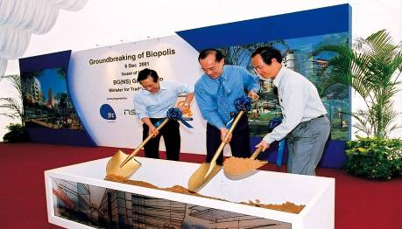
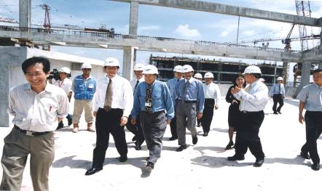
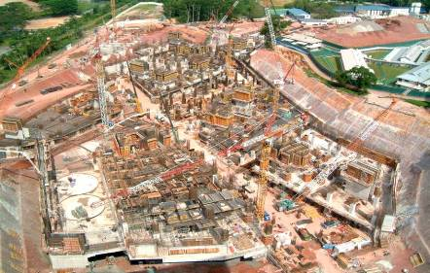
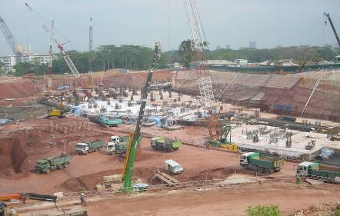
Breaking Ground in Dec 2001: Biopolis Phase 1

Slide 9
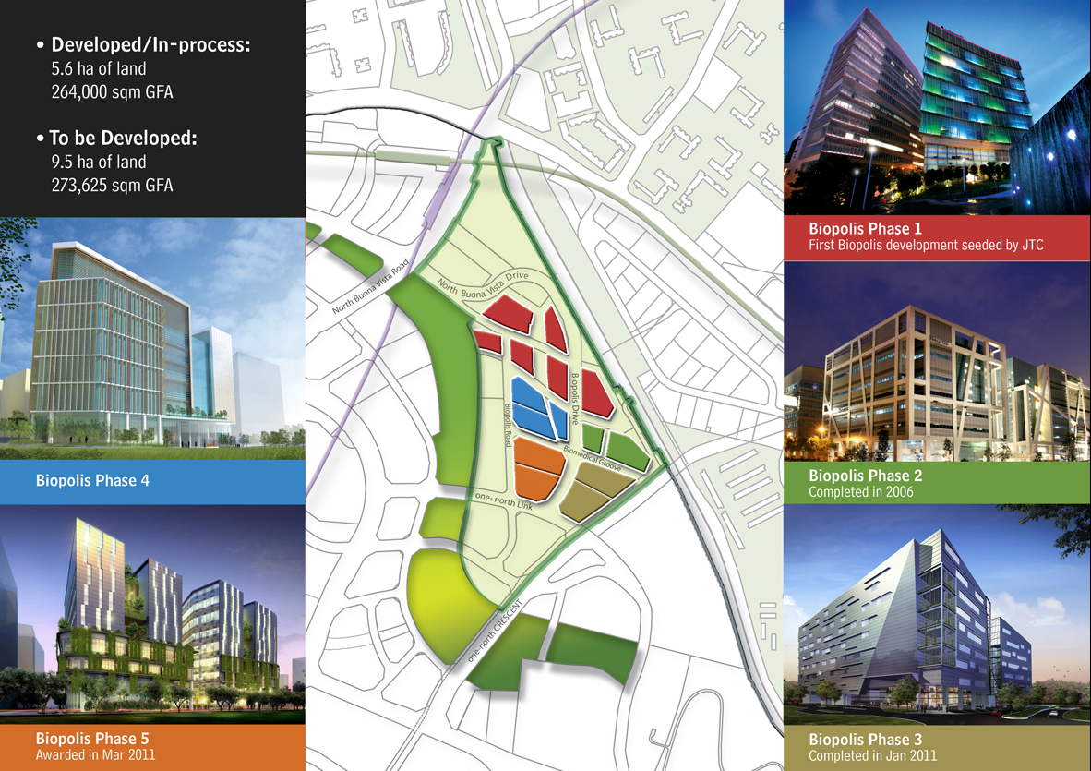
Developed :
5.6 ha of land
264,000 sqm GFA
In-process :
9.5 ha of land
273,625 sqm GFA
BIOPOLIS MASTERPLAN
(537, 625 SQ M)
5,787,000 SQ FT
(under construction)
Biopolis Phase 5
(under construction)

Slide 10










Pharma HQs in Singapore
Pharmaceutical companies with Regional HQs in Singapore
Highlights of Headquarters in Singapore
GSK’s Emerging Markets & Asia-Pacific Hub
Quintiles’s Asia-Pac Regional Headquarters
Novartis’s Regional Headquarters for Asia Cluster
Regional headquarters and control tower for all of GSK’s operations in Asia-Pacific, Latin America, and African regions
Quintiles Singapore functions as Asia-Pac headquarters providing a full range of clinical development and commercialization services
Regional headquarters for pharmaceutical operations across Asia cluster

Slide 11


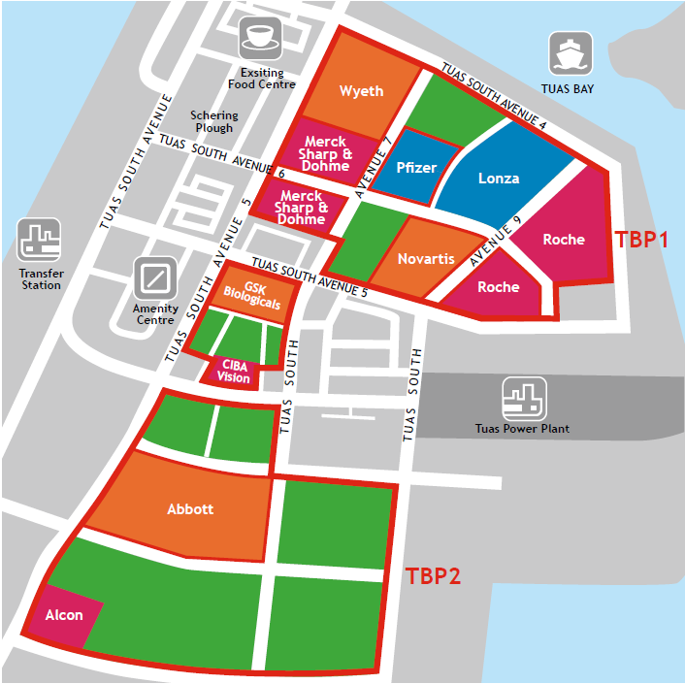





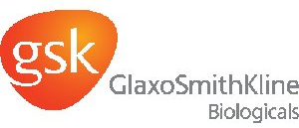



Pharma Manufacturing Plants
Tuas Biomedical Park
Bulk API and secondary manufacturing plants
Bulk biologics manufacturing plant
Cell Therapy Facility
Microbial and mammalian bulk biologics facility
1
3
Bulk API plants with pilot facility and pediatric vaccines plant
Tablet facility
Biologics Manufacturing Facility
Bulk nutritionals
plant
2
Bulk API and nutritionals
plant
Biologics and recombinant therapies plant
Bulk API intermediates plant
Vaccines plant
Quality & Operational Excellence
Zero major observations with regulators
Track record producing for global markets
Strong global logistics
Secure business environment
Access to talent
Manufacturing for the world
28 commercial scale manufacturing facilities
7 of the top 10 Big Pharma
API, biologics, cell therapy, nutrition

Slide 12











Pharma Manufacturing Growth in Singapore
Biologics, new modalities, process development centres
OUTPUT
(S$’000)
Nutritionals facilities
Bulk biologics facilities
Bioprocess, process development lab
28 Manufacturing facilities
S$25.1B (US$20.1B) output
10.7% growth in 2012
5,800 employees
Multi-purpose API, drug product facilities
2001
2003
2005
2007
2009
2011
2012
YEAR

Slide 13









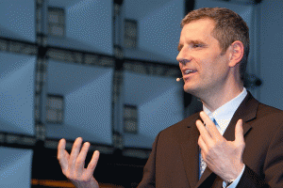
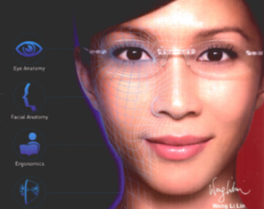

MedTech Company HQs
The Top 10 Medical Device Companies have Regional HQs in Singapore
Highlights of Headquarters in Singapore
Becton Dickinson’s Shared Services Centre
Siemens Medical Instruments Global Headquarters
Essilor’s Asia-Pacific Headquarters and R&D Hub
Shared services hub supports all BD’s operations in Asia-Pacific region.
Global HQ for hearing aids business. Singapore R&D and Manufacturing facility supplies 30% of the world’s hearing aids
Asia-Pacific R&D centre and coordination hub developing lenses for Asian consumers.

Slide 14





























MedTech Cluster in Singapore
35
26
29
Manufacturing Plants
R&D Centers
Regional HQs
9,666 employees
500 Researchers & Engineers
1,500 employees

Slide 15
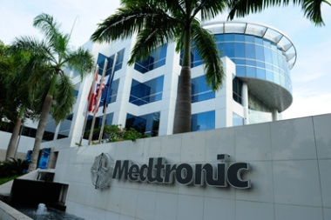
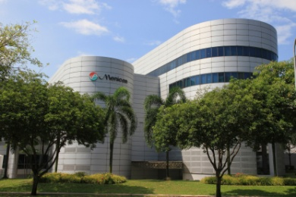
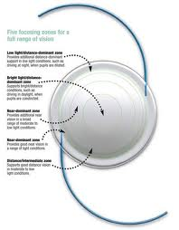

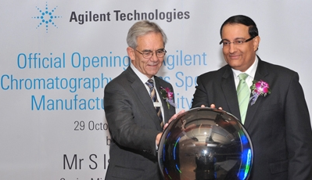
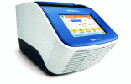

Recent MedTech Investments
Manufacturing
R&D and Innovation
Headquarters
Hoya Surgical Optics
Global Headquarters
Medtronic Pacemaker Manufacturing Facility
Menicon R&D Centre and Manufacturing Facility
Medtronic opens manufacturing facility for cardiac rhythm disease management (CRDM), which will produce pacemakers and leads.
Menicon established its first R&D and manufacturing facility for its new line of daily disposable “Flat Pack” contact lenses in Singapore.
Hoya Surgical Optics relocates its global headquarters from California, US to Singapore.
Agilent Instrument Manufacturing
Life Technologies Global Instrument Centre of Excellence
Siemens Medical Instruments Global Headquarters
Agilent Technologies opens its new life sciences manufacturing facility to produce Liquid Chromatography/Mass Spectrometry instruments for global markets.
Life Technologies established its Global Instrument Centre of Excellence in Singapore.
Siemens Healthcare relocates its Audiology Group global headquarters in Singapore under Siemens Medical Instruments

Slide 16
BENCH
BIOMEDICAL SCIENCES DIRECTION
BEDSIDE
Basic
Translational
Clinical
Service Delivery
Research Institutes
Institute of Molecular & Cell Biology
Genome Institute of Singapore
Institute of Bioengineering & Nanotechnology
Bioprocessing Technology Institute
Bioinformatics Institute
NUS School of Medicine
NUS Cancer Science Institute
Duke-NUS Graduate Medical School
Institute of Medical Biology
Skin Basic & Translational biology
Genetic Diseases
Regenerative Medicine (including stem cells)
Experimental Therapeutics Centre
Drug Discovery & Development from target validation to early phase clinical trials
Consortia
Singapore BioImaging Consortium
Singapore Immunology Network
Singapore Stem Cell Consortium (now subsumed into IMB)
Singapore Institute for Clinical Sciences
Develop programmes in translational & clinical medicine
Focus on Growth, Development & Metabolism
Develop Clinician Scientists
Ministry of Health
Ethical regulations/framework for clinical research, e.g. IRBs
HSA – Evaluation capabilities for new technologies
National Medical Research Council
Clinical research strategy
Grant management
Manpower development
Getting research outcomes into usage in patient care
Hospital Institutions
1. Tertiary Centres
National University Hospital
National University Cancer Institute
National University Heart Centre
Outram Campus
Singapore General Hospital
National Cancer Centre
National Heart Centre
National Neuroscience Institute
Singapore National Eye Centre
Duke-NUS Graduate Medical School
Others with specific capabilities
KK Women and Children’s Hospital
Tan Tock Seng Hospital
Public Sector Healthcare Groups
Singapore Health Services
Singapore General Hospital
KK Women and Children’s Hospital
National Cancer Centre
National Dental Centre
National Heart Centre
National Neuroscience Institute
2. National Healthcare Group
Tan Tock Seng Hospital
Institute of Mental Health
National Skin Centre
Communicable Disease Centre
3. National University Health System
National University Hospital
National University Cancer Institute
National University Heart Centre
Alexandra Health
Khoo Teck Phuat Hospital
5. Jurong Health
Alexandra Hospital
Ng Teng Fong General Hospital
6. Eastern Health Alliance
Changi General Hospital
Private Sector Healthcare Groups
Parkway Group
Raffles Medical Group
Thomson Medical
16

Slide 17
Public Research Infrastructure
Biopolis
IMCB
IBN
GIS
BTI
BII
NUS
SICS
YLLSoM
SIgN
IMB
ETC-D3
SBIC-
CIRC
NTU
CSI
NUHS
SCRI
SCELSE
NHG
MBI
LKC SOM
Outram Campus
SSHSPH
Novena Campus
SingHealth
Duke-NUS GMS
Kent Ridge Campus
IMCB – Institute of Molecular & Cell Biology
IBN – Institute of Bioengineering & Nanotechnology
GIS - Genome Institute of Singapore
BTI - Bioprocessing Technology Institute
BII - BioInformatics Institute
SigN – Singapore Immunology Network
IMB – Institute of Medical Biology
ETC-D3 – Experimental Therapeutics Centre-Drug Discovery & Development
SBIC-CIRC – Singapore BioImaging Consortium-Clinical Imaging Research Centre
SCRI – Singapore Clinical Research Institute
LKC SOM – Lee Kong Chian School of Medicine
NHG - National Healthcare Group
NTU - Nanyang Technological University
SCELSE – Singapore Centre on Environmental Life Sciences Engineering
YLLSoM - Yong Loo Lin School of Medicine
NUHS - National University Healthcare Singapore
SSHSPH – Saw Swee Hock School of Public Health
NUS - National University of Singapore
SICS - Singapore Institute for Clinical Sciences
CSI - Cancer Science Insittute
MBI - MechanoBiology Institute
Notes:
Education:
1990: 2 Universities, 1 Medical School
Today: 4 Universities , going on to 6 Universities, 3 Medical Schools and 1 School of Public Health
Research Institutes:
1990: 2 – GINTEC & IMCB
Today: 20 RIs & Centers integrated under 1 A*STAR umbrella
Today:
A*STAR research institutes & consortia
2 Academic Medical Centres: Kent Ridge & Outram
3rd Medical School: NTU
Universities & Research Centres of Excellence
CREATE research centres
Clinical research institutes
RCE SCELSE: Singapore Centre on Environmental Life Sciences Engineering world leading centre in biofilm research

Slide 18






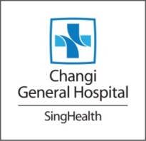























Public Research Collaborations
With Hospitals, Industry, Academia
Notes:
Education:
1990: 2 Universities, 1 Medical School
Today: 4 Universities , going on to 6 Universities, 3 Medical Schools and 1 School of Public Health
Research Institutes:
1990: 2 – GINTEC & IMCB
Today: 20 RIs & Centers integrated under 1 A*STAR umbrella
Today:
A*STAR research institutes & consortia
2 Academic Medical Centres: Kent Ridge & Outram
3rd Medical School: NTU
Universities & Research Centres of Excellence
CREATE research centres
Clinical research institutes
RCE SCELSE: Singapore Centre on Environmental Life Sciences Engineering world leading centre in biofilm research

Slide 19
Public-Private R&D Partnerships
Public-Private Research
Partnerships
Novartis
Roche
Bayer
Fluidigm
ARKRAY
L’Oreal
Public
R&D
Private
R&D

Slide 20
Gross Expenditure on R&D
GERD – Gross Expenditure on R&D
BERD – Business Expenditure on R&D
PUBERD – Public Expenditure on R&D
Notes:
Measuring outcomes of R&D Investments:
Development of Research Environment
Human Capital
Knowledge & Innovation Capital
Industry Capital

Slide 21
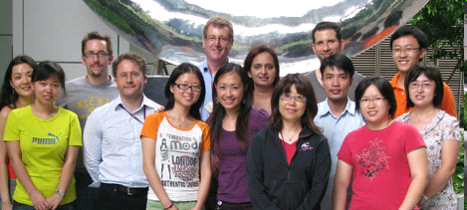
Commitment to R&D
R&D Expenditure as a percentage of GDP (%)
Gross Expenditure on R&D (GERD) $m
National
Technology
Plan
(1991-1995)
US$1.5 bn
National
Science &
Technology Plan
(1996-2000)
US$3 bn
Science &
Technology
Plan 2005
(2001-2005)
US$4.8 bn
Science &
Technology
Plan 2010
(2006-2010)
US$10.7 bn
Research, Innovation & Enterprise Plan
(2011-2015)
U$12.3 bn
5-year
S&T Plans
Notes:
Singapore’s government has committed about 1% of the country’s GDP to R&D. Our target is for Gross domestic expenditure on R&D (GERD) to reach 3.5% of GDP by 2015. This will put Singapore alongside research intensive countries like Sweden, Israel, Japan and South Korea.
It should however be noted that as Singapore’s economy is comparatively smaller, the absolute quantum is just a fraction of say China’s R&D expenditure, even though by % of GDP it seems to suggest otherwise.

Slide 22
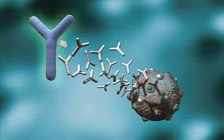

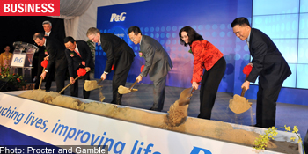

Gross Expenditure on BMS R&D
Moving up the value chain from manufacturing to innovation
BUSINESS EXPENDITURE ON R&D for BMS
US$460 mil (2011)
CAGR (2011): 26%
Chugai Pharmbody Research
Established in July 2012
S$200M (US$160.3M), 60 jobs
P&G Innovation Centre
TOP in Nov 2013
S$250M (US$200.4M), 500 jobs
First Asian research center outside Japan
S$9.1M (US$7.3M) over 5 years
Source: National R&D survey 2011, Singapore

Slide 23

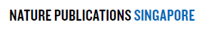
Knowledge & Innovation Capital
Papers
Patents
Country Rankings 2012
Overall: 5th
Most productive among top 5 countries
CAGR: 10.3%
CAGR: 34.5%
No. of articles
Based on A*STAR & extramural projects managed by A*STAR ETPL
CAGR: 21%
Start-Ups
No. of articles
Since 2000
>20
BMS Start-ups
(From A*STAR only)
Notes:
Intellectual Capital measured by scientific outcomes
Nature Publishing Index:
Ranked 5th in 2011 and 2012
Based on whole of Singapore figures
A*STAR Biomedical Publications
Based on no. of papers published by BMRC RIs
Patents
Figures include patent applications filed (active) for both priority and secondary filings from intramural and extramural funded BMS projects.
- Figures accurate as at 31 March 2013
Start-ups
Based on start ups by ETPL, data accurate as at 26 August 2013

Slide 24



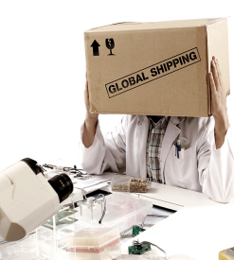
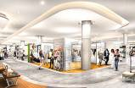






Financing & Support Programmes for Start-ups
Support
Grant
Equity
YES! Schools
Provides schools with grants to put in place a entrepreneurship learning programme for their students.
Action Community for Entrepreneurship (ACE) Start-ups
Provides grant support to entrepreneurial Singaporeans to set up their business on a $7 : $3 matching basis
Equity-based co-financing for Singapore-based start-ups with innovative products and /or processes.
Incubator Development Programme (IDP)
Grant support for incubators & venture accelerators that assist innovative startups.
Technology Enterprise Commercialisation Scheme (TECS)
Support early-stage Proof-of-Concept (POC) and Proof-of-Value (POV) projects
*at least 30% equity owned by Singapore citizens / permanent residents
YES : Young Entrepreneurs Scheme
24

Slide 25





Equity Related Programs
Co-Investment Approach
Programs
SPRING
Strategic Partners
SPRING SEEDS
Biomedical Sciences Accelerator (BSA)
Capital & Value-add
Broad-based program for start-ups in multiple sectors
Medtech start-ups raising first round of institutional funds
Start-ups
Co-invest up to SGD$1.5 Mil
(US$1.2 Mil)
Co-invest up to SGD$4 Mil
(US$3.3 Mil)
Our partners include…

Slide 26
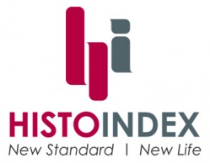


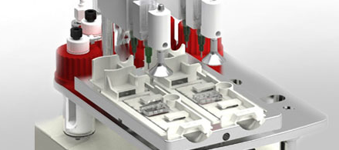
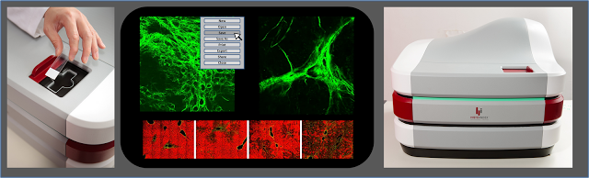
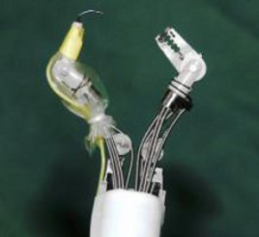
MedTech Start-ups Supported by SPRING
Supported through TECS Proof-of-Concept / Proof-of-Value Grants and /or SPRING SEEDS investment
~ 40 local Med Tech Start-ups currently being helped
Spin-off from National University of Singapore (NUS); advisors include founder of Biosensors Int’l.
Developed non-invasive “liquid biopsy” platform using a microfiltration biochip to isolate rare CTCs from whole patient blood.
Raised institutional round in 2013 from Vertex Venture
Spin-off from A*STAR’s Institute of Bioengineering & Nanotechnology.
World’s first stain-free, 3D, quantitative imaging solution for visualizing and staging liver fibrosis.
This provides critical information not currently available with existing stain-based imaging techniques
Spin-off from Nanyang Technological University
Robot-assisted surgical system in which a surgeon uses a joystick controller to control 2 robot arms mounted on a tip of an endoscope, guided by images sent from a camera mounted on the same tip.
Limited human trials with positive results – less discomfort, faster healing time.
Secured strategic investment from Hoya Group in Aug 2013
Notes:
Clearbridge BioMedics (CBB) is a spin-off from National University of Singapore (NUS) and is also the first incubatee of Clearbridge Accelerator, a Singapore Government (National Research Foundation) backed high-technology incubator. CBB is also a successful recipient of SPRING Singapore’s Technology Enterprise Commercialisation Scheme (TECS) Proof-of-Value (POV) Grant.
Leveraging on a patent-pending microfluidic biochip invention, our ClearCell™ System, comprising the ClearCell™ Unit and a range of CTChips®, are able to effectively detect and isolate wholly intact Circulating Tumour Cells (CTCs) from patients' blood samples. CTCs are extremely rare cancer cells that have detached from a primary tumour and are circulating in the bloodstream. Capturing and counting CTCs could enable clinicians to conduct cancer screening, diagnosis and post-cancer monitoring that will be invaluable in allowing clinicians to make timely and life-saving decisions. Most impressively, the ClearCell™ System is able to capture and retrieve these CTCs, allowing researchers to conduct critical genetic analysis to optimise cancer therapies, paving the way for personalised cancer treatment.
The ClearCell™ System aims to be the next generation of non-invasive “liquid biopsy” approach for cancer screening, diagnosis, staging, personalised medicine, and treatment monitoring.
Headquartered in Singapore, Clearbridge BioMedics currently has customers spanning Asia, Europe and North America.
Situation
Current CTC detection methods present some shortcomings:
Specific biomarkers may leave some CTCs undetected
CTCs adhered to the devices via antibodies & thus cannot be retrieved.
CTCs are no longer viable in their native state
Other existing methods are costly and may require painful invasive tissue biopsy and/or whole body CT scan where testing and imaging procedures are costly and cumulatively detrimental to patient health.
Need for paradigm shift into non-invasive “liquid biopsy” where better isolation and retrieval techniques without compromising the integrity of the CTCs can be achieved and thereafter used for downstream analysis and treatment guidance.
Solution
Company aims to address the entire spectrum of cancer management through screening, diagnosis and determination of treatment decision, towards personalised cancer therapy and effective monitoring. This is done through isolation and retrieval of CTCs and other rare cells from blood sample, a paradigm shift towards next generation non-invasive “liquid biopsy” for gathering of real-time feedback.
Patent pending and patented mechanics-based microfluidic biochips that are dependent on size and deformability of CTCs, allowing for isolation and retrieval of CTCs from blood samples of patients in their native state.
Label-free, passive system that does not require any pre-selecting biomarkers nor external electrical or magnetic fields. Cell viability is maintained and these isolated cells can be thereafter retrieved for downstream analysis.
Wenyou’s writeup
CBB aims to address the entire spectrum of cancer management through screening, diagnosis and determination of treatment decision, towards personalized cancer therapy and effective monitoring. Its proprietary ClearCell System is able to effectively detect, isolate and retrieve wholly-intact circulating tumour cells from patients’ blood samples. This has numerous applications in the areas of cancer screening, diagnosis and treatment monitoring. The range of cancers detectable by the ClearCell System includes lung, breast, colorectum, stomach and prostrates cancers. This is a paradigm shift towards next generation non-invasive “liquid biopsy” for gathering of real-time feedback.
There are 12 million new cases of cancer every year and these cancers are responsible for 7.5 million deaths every year. The industry is projected to grow in size to more than $100 billion by 2013. The early detection is key to effective treatment and survival. Clinicians need real-time feedback to monitor treatment effectiveness and guide treatment decisions. The retrieval of CTCs is highly-touted as a solution to detecting early-stage cancers.
CBB intends to scale via staged market entry – Research Use Only (RUO), Cell Enrichment Device (CED) and In-vitro diagnostics (IVD). Company will first focus on RUO – selling device, the chips and installations services to research labs. Company has engaged with clinical collaborators and key opinion leaders (KOLs) in the CTC space, including the Mayo Clinic and MD Anderson Cancer Research, NIH, and with pathology labs to help proliferate the technology. After which, they will develop CEDs which will allow for the retrieval of CTCs for downstream analysis. Company has identified and started engagement with product development Company, Cambridge Consultants^{[1]} (which provides product development engineering services) and various contract manufacturers for product development and production. Finally, the company will go into the development of IVD for the different cancers.
^{[1]} Cambridge Consultants are selected out of several engineering companies because they possess microfluidic experience, IVD experience, Blood testing facility, ISO 13485- certified, which is crucial in the development of the product.

Slide 27
Clinical and Healthcare Outcomes
Clinical trials
Healthcare Outcomes
Evidence-based dengue hospital admission criteria
40% reduction in hospitalisation rate, $1.8 mil (US$1.4 mil) savings
HLA-screening before treatment with carbamezipine
Drop in severe adverse drug reactions
Total of 265 clinical trials in 2011
Notes:
What do you consider to be the most appropriate measures of health in the context of measuring the value of biomedical research (e.g., value of lives saved, value of reduced disability, value of reduced cost)?
The desired outcomes of research lie along a spectrum ranging from relatively short-term indicators such as publications and patents, to those that provide greater value-add but also longer time to realise in the form of licenses and companies sold, to macro economic indicators such as business expenditure on R&D (BERD) and creation of high-value jobs. Systemic health outcomes in the form of healthcare cost savings, improved patient care and better population health outcomes are some of the highest value-added outcomes but are also the most long-term.
At present, the Singapore government measures short-term quantitative indicators such as publications and patents, as well as mid-term quantitative indicators such as licenses and industry funding. Although it is desirable to track systemic health outcomes arising from biomedical research such as cost savings for the healthcare system and direct benefits to patients and improved public health measures attributable to R&D, Singapore does not currently do so.
As the Singapore government plans for Research, Innovation and Enterprise (RIE) 2020, the framework for evaluating the value of biomedical research is being reviewed. During a recent retreat with the BMS community in August 2013, there was consensus among the participants that quantitative KPIs would need to be complemented by qualitative measures e.g. narrative on how the R&D helped derive benefits for patients. The BMS community also expressed views that the measurement of economic value and healthcare cost savings yielded from biomedical research are not easily measured and suggested to develop expertise in public healthcare economics (e.g. in Saw Swee Hock School of Public Health) to look further into the issue.

Slide 28
Clinical and Healthcare Outcomes
Systemic health outcomes:
  Includes healthcare cost savings, improved patient care and better population health outcomes
  Highest value-added outcomes but also the most long-term
Current measures of research outcomes in Singapore:
  Quantitative indicators e.g. publications, patents, licenses and industry funding
  Represent short to mid-term outcomes, not long-term outcomes
As we plan the next 5-year R&D plan - Research, Innovation and Enterprise (RIE) 2020 - the framework for evaluating the value of biomedical research is being reviewed:
  Strong consensus among the Singapore BMS community that quantitative KPIs should be complemented by qualitative measures e.g. narrative on how R&D derives benefits for patients
  Expertise in public healthcare economics needs to be developed; not easy to measure economic value and healthcare cost savings yielded from BMS research

Slide 29
Clinical and Healthcare Outcomes
BMS Initiative, besides contributing to the economy and creating quality jobs,
has helped Singapore and our region's health outcomes. Examples :
A much greater understanding that there is such an entity as the "Asian Phenotype", where diseases such as lung cancer, heart failure, dementia, diabetes have a different presentation and thus treatment and outcome, compared with the same disease in largely Caucasian populations in the West. It also highlights the need to invest in pharmaco-genomics and pharmaco-vigilance after drugs are approved and widely marketed.
2. Enhanced international collaboration:
* Singapore has helped improve pediatric leukemia survival in Malaysia by sharing of clinical protocols as part of a multi-center clinical trial
* Stimulated basic science collaboration with , e.g. Genome Institute of Singapore-National University of Singapore (NUS)/National University Hospital System(NUHS)-Harvard collaboration in lung cancer stem cells (Cell), and NUS/NUHS-Harvard collaboration in liver cancer (New England Journal of Medicine)

Slide 30
Basic Research is an investment in the future
Determining the structure of DNA
Relenza, the world’s first cure for influenza, arose from the crystal structure determination of the enzyme, neuraminidase used by the influenza virus to get into cells.
New England Biolabs (NEB) 1975 : “ many of those early restriction enzymes were discovered at my lab in CSHL…Rich Roberts “
ZFRs, TALENs, CRISPRs -- Explosion in genome engineering tools for stem cells/mouse model research came from basic research in Plants (early 2000), Bacteria and Bioinformatics tools (2005), thus changing the drug discovery pipeline.
Commercializing research discoveries is a present necessity; the funding of basic research must be a long term pursuit.
Keep the line between Basic and Applied “Blurry”
ZFRs Zinc finger recombinases
TALENs Transcription activator-like effector nucleases
CRISPRs Clustered regularly interspaced short palindromic repeats

Slide 31
Building Up R&D Human Capital
Research Scientists & Engineers (RSEs) grew from 4,300 to 29,480 (between 1990-2011)
RSEs in the private sector grew more than tenfold from 1,360 to 16,540
Source: R&D Survey of Singapore
Manpower Growth | Public | Private | Total
CAGR 1990-2011(PhD) | 9.6% | 16.4% | 10.4%
CAGR 1990-2011(Overall) | 7.3% | 12.6% | 9.6%
56% of total RSEs work in the private sector
30
Notes:
Research Scientists & Engineers (RSEs) grew from 4,300 to 29,480 (between 1990-2011). RSEs in the private sector grew more than tenfold from 1,360 to 16,540
(figures rounded to nearest 10)

Slide 32
BMS R&D Human Capital
Private Sector
Public Agencies
CAGR: 18.3%
CAGR: 11.3%
4,147
1,280
1,274
202
Source: National R&D survey 2011
Notes:
BMS Outcomes (1):
Investments in BMS have resulted in a high value R&D workforce both in the private and public sectors
- ~6-fold increase in number of graduates (Bachelors/Masters/PhDs) in private sector, from 2000 to 2011
- ~3-fold increase in number of graduates (Bachelors/Masters/PhDs) in public sector, from 2000 to 2011

Slide 33

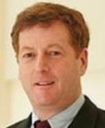





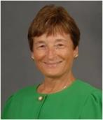
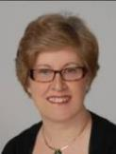
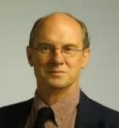


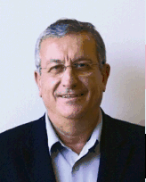




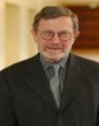




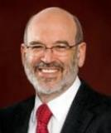
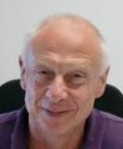
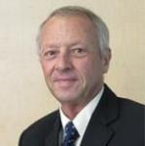
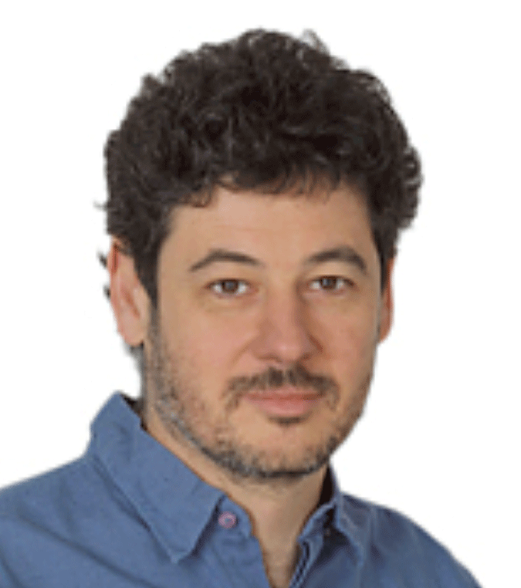
Building up Human Capital: Catch a few Whales
Senior Scientific Leaders to help develop local talent
Dr Philippe Kourilsky Chairman, SIgN
Dr Alan Colman
Exec Dir, SSCC
Prof Paola
Castagnoli
Scientific Dir,
SIgN
Dr Edward Holmes
Exe Dy Chmn (TCSG),
BMRC &
Chmn, NMRC
Dr Judith
Swain
Exec Dir, SICS
Dr Dale Purves
Exec Dir, NRP
Dr Sydney Brenner
Scientific Adviser, A*STAR
Dr David Srolovitz
Exec Dir, IHPC
Prof Charles Zukoski
Chmn, SERC
Sir George Radda Chmn, BMRC
Prof Dim-Lee Kwong
Exec Dir, IME
Dr Keith Carpenter
Exec Dir, ICES
Dr Pantelis Alexopoulis,
Exec Dir, DSI
Dr Frank Eisenhaber
Director, BII
Dr Phil Ingham
Dy Dir, IMCB
Sir David Lane
Chief Scientist
Dr Birgitte Lane
Exec Dir, IMB
Dr Alex Matter
Director, ETC
Dr Edison Liu
Exec Dir, GIS
Dr Jean Paul
Thiery
Dy Dir, IMCB
Dr Davor Solter
PI, IMB
Prof David
Townsend
Head of PET and SPECT Group, SBIC
Dr Jackie Ying
Exec Dir, IBN
Prof Stephen Quake
Consultant
Prof Peter Gluckman
PI, SICS
Dr Stephen Cohen
Acting Exec Dir, IMCB

Slide 34
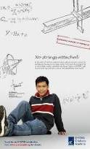
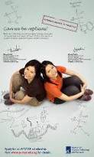
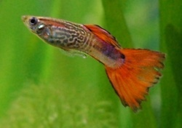
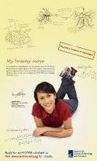
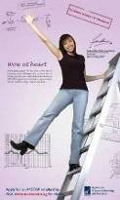
Local Human Capital – Grow PhD Guppies
Guppy – 0.03 meters

Slide 35


Long Term Human Capital Pipeline
Evelyn Thangaraj
2005 A*STAR YRAP Scholar from India
(currently A*STAR Scholar, Medicine,
Imperial College, London)
Le Ngoc Phuong Lan
2005 A*STAR YRAP Scholar from Vietnam
(currently A*STAR Scholar, Pharmacy, University of London)
Senior
Guppies
Young
Whales
②
Guppies
①
② ③ ②
10-14 yrs
15-18 yrs
19-23 yrs
24-30 yrs
< 35 yrs
Youth
Science
YRAP &
A*STAR
Science
Awards
NSS(BS)
PGS
NSS(PhD)
AGS
SINGA
AIF
AGS
(Post-doc)
YRAP - Young Researchers Attachment Programme
A*STAR - Agency for Science & Technology Research
NSS - National Science Scholarship
PGS - Pre-Graduate Scholarship
AGS - A*STAR Graduate Scholarship
SINGA - Singapore International Graduate Award
AIF - A*STAR International Fellowship

Slide 36

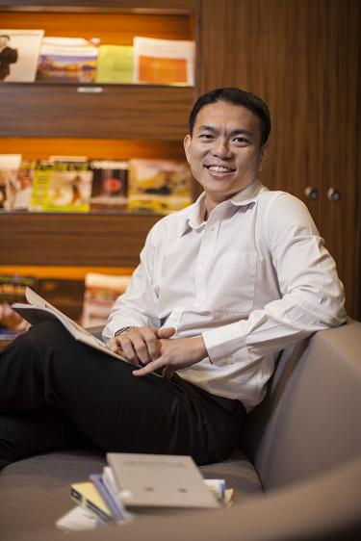
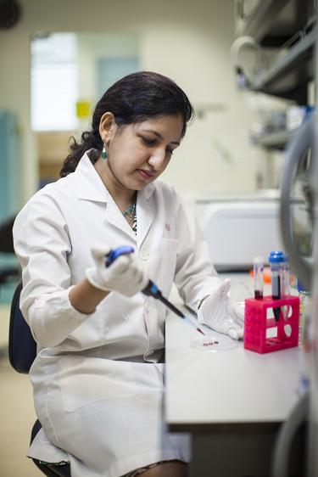
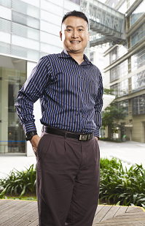
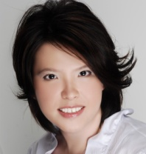
Nurturing a Pipeline of >1,200 Singaporean PhD Talent
Awarded more than 1,200 PhD Scholarships
to develop Singaporean R&D talent since 2001
More than 350 scholars have completed their PhDs and are contributing to Singapore’s Research, Innovation and Enterprise (RIE) environment
Dr Karen Crasta
Lee Kong Chian School of Medicine, Nanyang Technological University (NTU)
A*STAR International Fellow
NRF Fellow 2013
Dr Jonathan Loh Yuin Han
Principal Investigator, Institute of Molecular & Cell Biology (IMCB)
A*STAR Graduate Scholar
Dr Cheok Chit Fang
Principal Investigator, IFOM-p53 Lab
National Science Scholar (PhD)
Dr Melissa Fullwood
Yale-NUS College
Principal Investigator, Cancer Science Institute
National Science Scholar (BS-PhD)
NRF Fellow 2013
Dr Seah Kwang Hwee
Associate Patent Examiner, Intellectual Property Office of Singapore (IPOS)
A*STAR Graduate Scholar

Slide 37
Communicating the Value of Scientific Knowledge
Importance of Public Outreach in S&T:
Future of the scientific enterprise depends on public support for R&D
Develop the next generation of scientists and engineers
Build capacity for sustained long-term economic growth and improved quality of life
Role of Different Stakeholders in Public Outreach Efforts
Public policy-makers, scientists, teachers with the influence, corporations as part of Corporate Social Responsibility efforts

Slide 38
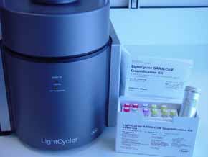
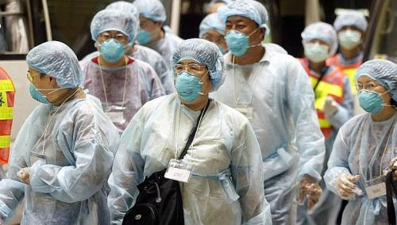
Communicating the Value of Scientific Knowledge
How Singapore Does It:
Framing the “Economic Development” story
Instilling the positive economic impact of our research (i.e. high value-added job creation) in the public mindset
Reiterating positive Societal outcomes which are relatable to the public e.g. 2003 SARS outbreak, Genome Institute of Singapore co-developed a sensitive and accurate SARS Diagnostic Kit with Roche

Slide 39


Communicating the Value of Scientific Knowledge
How Singapore Does It:
Enhancing public understanding of increasingly complex and urgent societal issues, and the role of R&D in addressing these issues
e.g. Ageing and Healthcare - Cutting-edge R&D (especially in telehealth) can potentially transform and improve the delivery of healthcare for millions, but the impact would be minimal if the public did not embrace the technologies

Slide 40
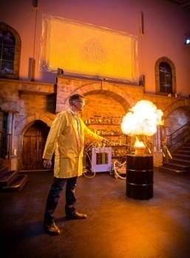

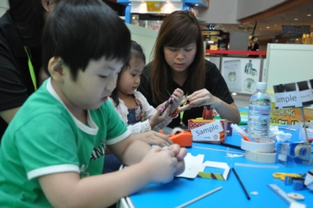

Communicating the Value of Scientific Knowledge
How Singapore Does It:
Platforms to reach out to students and the public and enhance appreciation of Science :
  Partnership with Singapore Science Centre and Ministry of Education
  Singapore Science Festival, STAR Lecture, Science in the Mall, Centre for Research and Applied Learning in Science, Singapore Academy of Young Engineers and Scientists, Teachers Local Research Attachment Program
STAR Lecture 2013
‘The Modern Alchemist’
Dr Peter Wothers, Cambridge University
Science in the Mall

Slide 41
Communicating the Value of Scientific Knowledge
Singapore Science Festival
Annual carnival spanning several weeks with events for students, parents and the general public to understand the application of science in our daily lives
Celebrates achievements of local innovators
STAR Lecture
A*STAR and Science Centre bring the Royal Institution’s Christmas Lecture to Singapore
Designed to bring Singaporean youths on a journey of scientific discovery and inspiration through an interactive discussion with a world-renowned scientist
Brings the attention of the nation’s youth to the ‘big picture’ questions in Science
Centre for Research and Applied Learning in Science (CRADL∑)
An open learning and research lab at the Science Centre Singapore
Develops teacher-mentors and enhance the capacity of teachers and schools in science research and innovation
Collaboration between Science Centre, A*STAR, DSO and MOE

