Slide 1
The Accountability Conundrum for Biomedical Research
NIH Scientific Management Review Board
October 24, 2013

Slide 2

Never Discuss Floods
With Noah In the Audience
Notes:
As I looked at the speakers from today and the invitee list, it was clear I shouldn’t try to give a straight neuroscience talk to this crowd or I”d violate the old adage…never discuss floods…so I’ll talk about things I’m more comfortable and familiar with…

Slide 3
You have covered most of the major ways to demonstrate the value of biomedical research
My thoughts surround an overlay of accountability demands on top of demonstrating overall value

Slide 4
The conundrum is that we tend to focus on overall value of our enterprise
Many people are now asking for more granularity
  Accountability at the level of “programs” or even individual grants

Slide 5
Start with the context in which all of this occurs….
The societal context for science and technology

Slide 6
As Dickens might say…..
The scientific enterprise is experiencing the best of times
And some of the worst of times
  That’s an exaggeration
    But things are pretty tough in some quarters
Notes:
We are living in both the best of times and the worst of times for science and society

Slide 7
On the one hand
We’re living in the best of scientific times
Notes:
We’re living in the best of scientific times. Advances in science – particularly neuroscience – are coming at a fantastic rate

Slide 8
Advances in science are coming at a fantastic pace
The rate of incremental advance is accelerating
New technologies are enabling quantum jumps in understanding
  With great practical significance
“Transformative” or “breakthrough” research is getting (somewhat) easier to get funded
Notes:
You all know about those…

Slide 9
Science and technology have never been more important or prominent in modern life

Slide 10
Some major global societal issues
Environmentally sustainable development
Need for renewable energy sources
Information and communications technology
Universal access to education
Poverty and economic opportunity
Technology-based manufacturing and jobs
Intellectual property rights
Terrorism
International security
Natural disasters
Science and technology capacity building
Vaccines and medical therapies against infectious diseases
Quality and accessibility of health care

Slide 11
Corollaries:
For people to prosper in modern society, they need fundamental understanding and comfort with S&T
For nations to prosper they need
  Scientific capacity
  National policies that reflect the best science
For science to prosper, the science-society relationship must be positive and strong

Slide 12
More and more countries are investing in science and building a national science enterprise
The motivation is typically tied to
Solving local problems
Overall health and quality of life of their people
Innovation and the economy

Slide 13
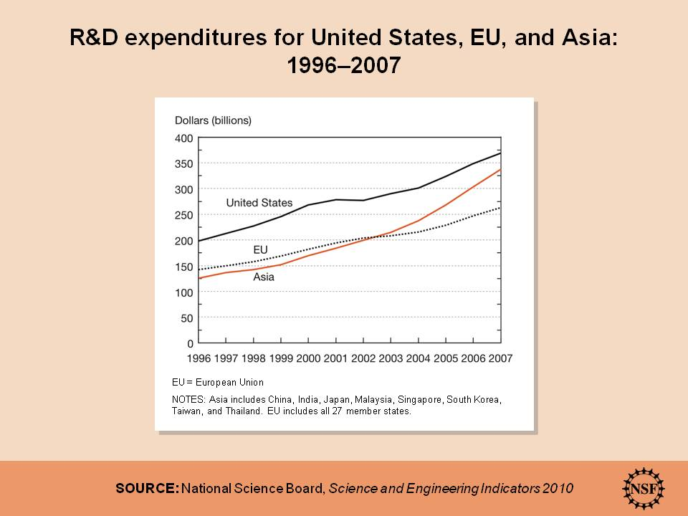

Slide 14
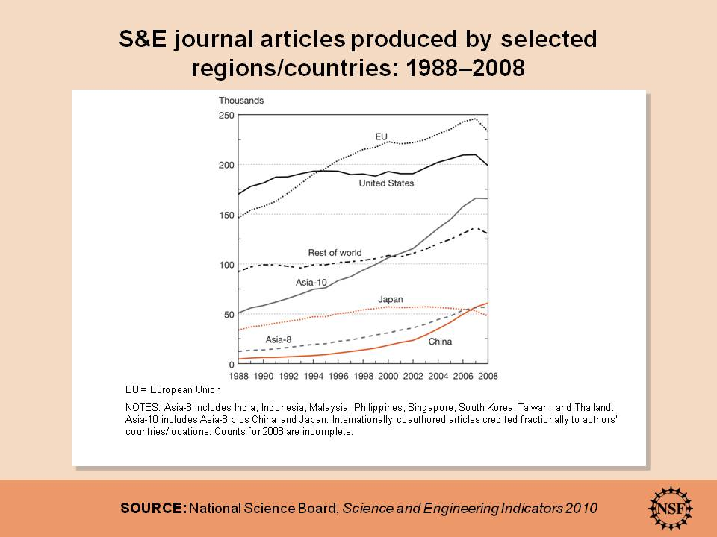

Slide 15
Conclusion: Science is going on in more and more parts of the world
The distribution and balance are shifting

Slide 16
Is this globalization good or bad?
If you’re particularly nationalistic – no!
  US is no longer #1 in every area of S&T
On the other hand
  “Science anywhere is good for science everywhere”
  NSF Director, Subra Suresh, 2012

Slide 17
In general, things are going extremely well
So what’s the problem?

Slide 18

The scientific enterprise is experiencing some significant turbulence

Slide 19
An array of forces are converging to make the overall climate for science rocky, at best
And these are contributing to more and more calls for “accountability”
  More than just showing the value of the enterprise

Slide 20
Some of the forces are internal to science…

Slide 21
An array of issues within science are not going so well…and negatively affect the broader (societal) context for science
Incidents of scientific misconduct
Human subjects concerns
Animal welfare issues
Conflict of interest problems
Publishing by press release
Hyperbolic or exaggerated claims
Appearing to suppress dissenting views
Mistakes in scientific papers

Slide 22
We need to ensure our house is in order!

Slide 23
These are factors internal to science
There are external pressures as well
  Not all are bad
    But shouldn’t be ignored

Slide 24
Funding is the BIG external factor
Prospects are iffy at best

Slide 26
Other factors are making things tough
American eminence in some fields is at risk

Slide 27
Losing eminence can have consequences
Fewer foreign students coming to the US
Potential brain drain of American scientists(?)
Fewer US-based science and technology breakthroughs
Fewer US start-up companies and jobs
Loss of public respect and trust

Slide 28
The broader science-society relationship is not so smooth

Slide 29
People generally still respect science and technology….
Notes:
Every survey shows that people generally still respect science and technology – depending on how you ask the question between 70 and 90% of Americans believe the benefits outweigh the risks of science and technology advances.

Slide 32
They have little understanding of what is and is not science
60% of Americans believe in extrasensory perception
47% still do not answer “true” to the statement: “Human beings developed from earlier species of animals”
41% think astrology is somewhat scientific
Science and Engineering Indicators, 2004

Slide 33
Science-society tension can result from
Widespread misunderstanding
  Vaccines and autism
  GMO’s
Political or economic inconvenience
  Climate change
Conflict with peer group beliefs
Conflict with core human values

Slide 34
Only scientists are stuck with what science says
The rest of the public can disregard, deny, or distort findings
  With relatively little immediate consequence

Slide 35
This science-society tension has consequences
Science is less able to serve societal needs
Society wants to exert influence on what science is (or is not) done
Public support of science is undermined
Public trust of science seems to be weakened

Slide 36
And is contributing to increasing calls for value and accountability
“What are we getting for all that money?”
“What are we getting for that (big) grant?”

Slide 37
Traditional measures of scientific productivity don’t satisfy most constituents
Number of grants
  E.g.,Number of R01s tied to Centers
Numbers of publications
Number of citations
Impact factors

Slide 38
“Tracebacks” often generalize (with examples) about contributions of the enterprise
Economic growth and competitiveness
National security
Health of the public

Slide 39
“Traceback studies” only help minimally
They’re the norm for the arguments
  But only go so far
  Can’t account on an individual or program level

Slide 40


Slide 41
“Traceback studies” don’t seem to be convincing enough
Many stakeholders now want to be assured that every grant (or grant program) will have impact

Slide 42
That philosophy led to
America COMPETES Act
  Called on NSF to develop a Broader Impacts criterion for proposal review and funding
Could well happen to NIH

Slide 43
Sec. 526 of America COMPETES Reauthorization Act of 2010
Instructs NSF to have a Broader Impacts review criterion for every grant to address one or more of several societal goals:
    Increased economic competitiveness of the United States.
    Development of a globally competitive STEM workforce.
    Increased participation of women and underrepresented minorities in STEM.
    Increased partnerships between academia and industry.
    Improved pre-K–12 STEM education and teacher development.
    Improved undergraduate STEM education.
    Increased public scientific literacy.
    Increased national security.
Notes:
ACRA enacted in January 2011
Sec. 526 directly addressed the Broader Impacts review criterion
Task Force harmonized its recommendations with the goals and intent of this legislation

Slide 44
NSF’s Merit Review Criteria:
Review and Revisions
A Report of the National Science Board

Slide 45
Broader Impacts Criterion
Strengths:
  Ensures the connection between scientific research and society
Weaknesses:
  Guidance is very unclear on:
    Expectations for nature of, and support for, proposed activities
    How to review the proposed activities
Notes:
Strengths and weaknesses of the current Broader Impacts review criterion

Slide 46
Three Merit Review Principles
All NSF projects should be of the highest quality and have the potential to advance, if not transform, the frontiers of knowledge.
NSF projects, in the aggregate, should contribute more broadly to achieving societal goals. These “Broader Impacts” may be accomplished through the research itself, through activities that are directly related to specific research projects, or through activities that are supported by, but are complementary to, the project.
Notes:
The Task Force identified three major guiding principles, to help clarify the intent of the review criteria, and how they should be used by PIs, reviewers, and NSF staff.
#1 is self-explanatory
#2 – it is worth noting that the Task Force recognizes that an NSF project may produce Broader Impacts three ways:
Through the research itself
Through activities that are directly related to the research project
Through activities that are complementary to the project

Slide 47
Three Merit Review Principles (continued)
Meaningful assessment and evaluation of NSF funded projects should be based on appropriate metrics, keeping in mind the likely correlation between the effect of broader impacts and the resources provided to implement projects. If the size of the activity is limited, evaluation of that activity in isolation is not likely to be meaningful. Thus, assessing the effectiveness of these activities may best be done at a higher, more aggregated, level than the individual project.
Notes:
(text from the report, worth repeating here):
With respect to the final principle, the Board wishes to emphasize that, even if assessment of Broader Impacts outcomes for particular projects is done at an aggregated level, PIs are expected to be accountable for carrying out the activities described in the funded project. Thus, individual projects should include clearly stated goals, specific descriptions of the activities that the PI intends to do, and a plan in place to document the outputs of those activities.

Slide 48
How did that work out?
We’re not sure yet
Draft of the “High Quality Research Act”
  Asked NSF Director to certify every grant is relevant to
    National Security
    Economic competitiveness
    Health of the public
Reauthorization of America COMPETES is now on the table

Slide 49
Not just happening in the US
RC-UK asks scientists to delineate impact plans
  Plus pathways to impact
    How help the beneficiary benefit
  RC will help pay to make the impacts happen

Slide 50
Will this level of accountability be asked of biomedical research?
While we are worrying the “value of biomedical research”
  Should we be worrying more about showing the value of specific research projects and programs?

Slide 51
Should we be better attending to pressures on other fields of science?
And view “value” in a much narrower sense than we have traditionally

Slide 52
We can no longer get away with asserting productivity by citing
Traditional scientific productivity standards
Examples of historical (traceback) outcomes

Slide 53
We need to better articulate concrete outcome measures for
Contributions to the progress of science
Improvements in health care and health practice

Slide 54
And then evaluate “programs of research” against them
Hopefully we can avoid greater granularity

Slide 55
There’s a growing community of scholars working on this set of issues
NSF’s Science of Science Policy

Slide 56
Should this approach be more formalized for biomedical research?

